Slide 1
A Brief History of the Internet’s Biggest BGP Incidents
Jac Kloots
Solutions Engineer
jac@kentik.com

Slide 2
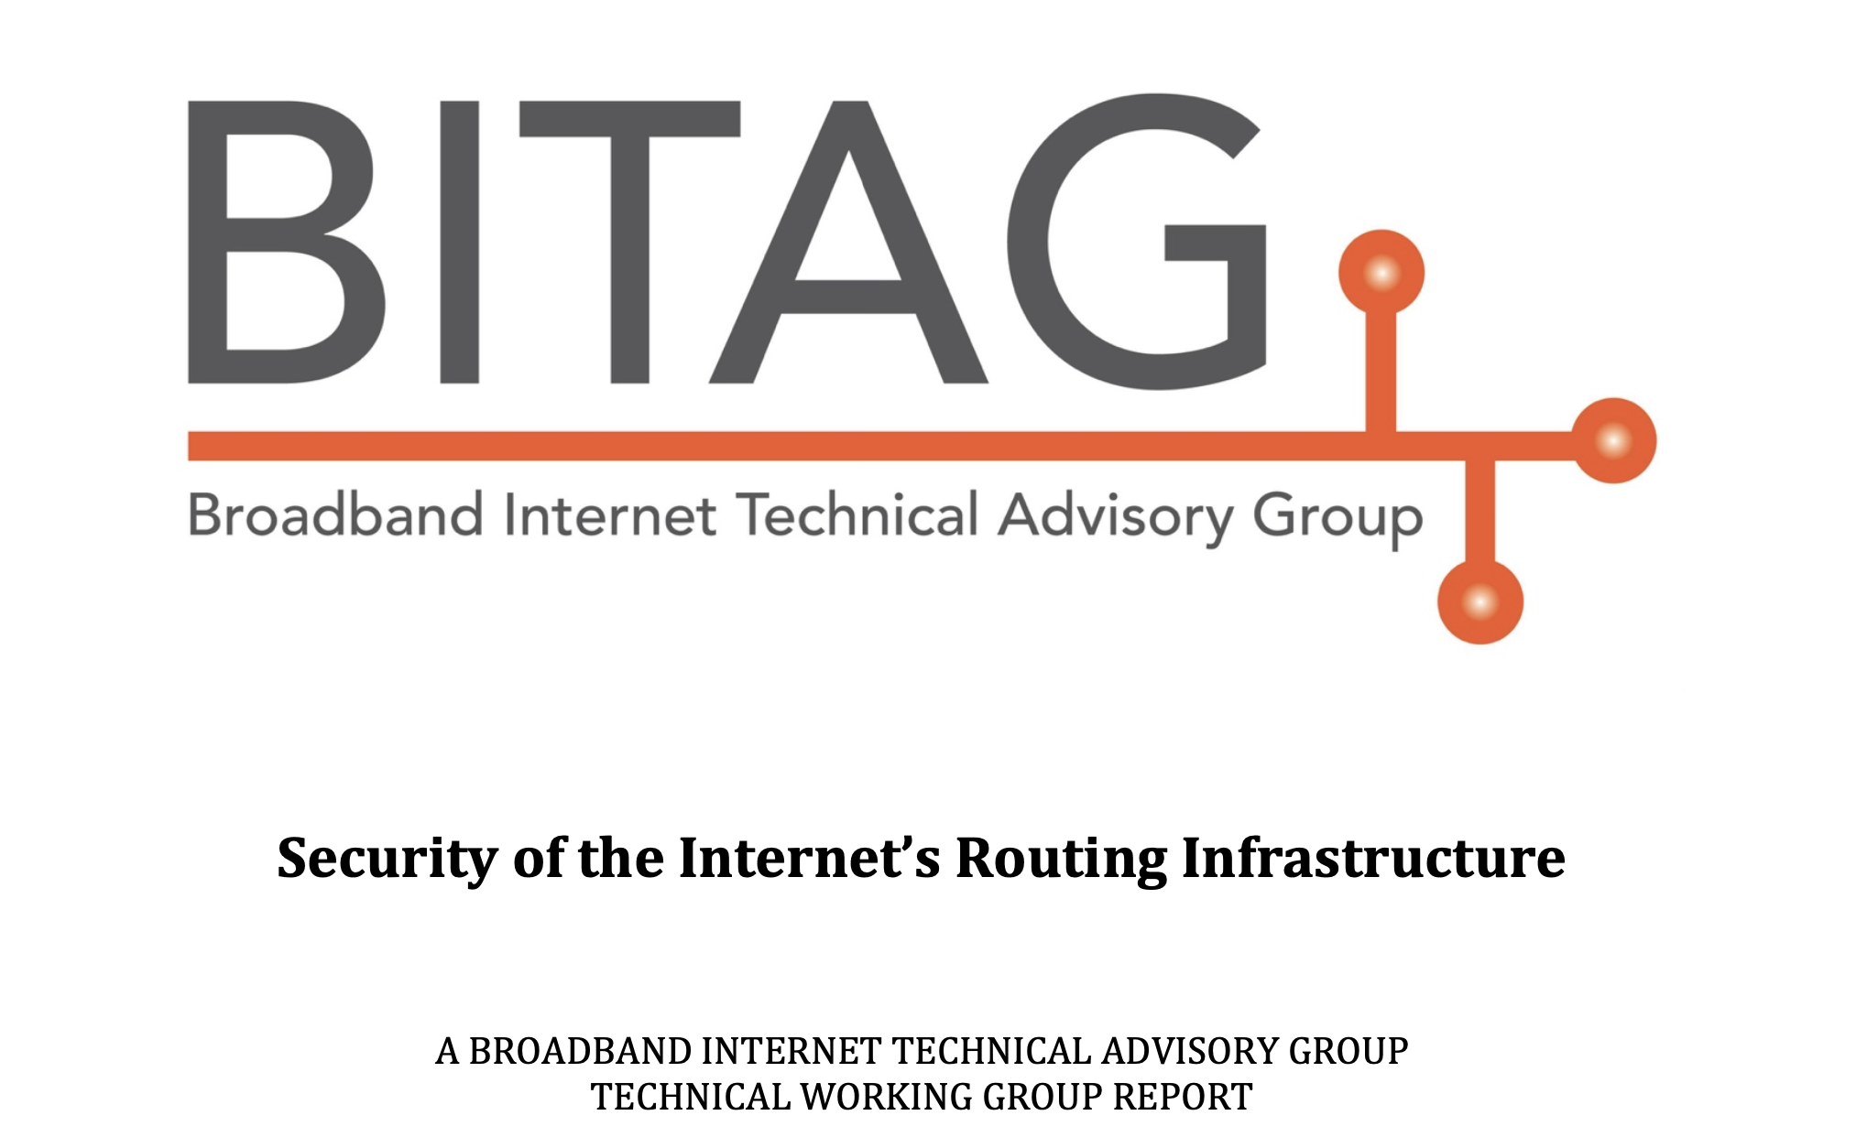
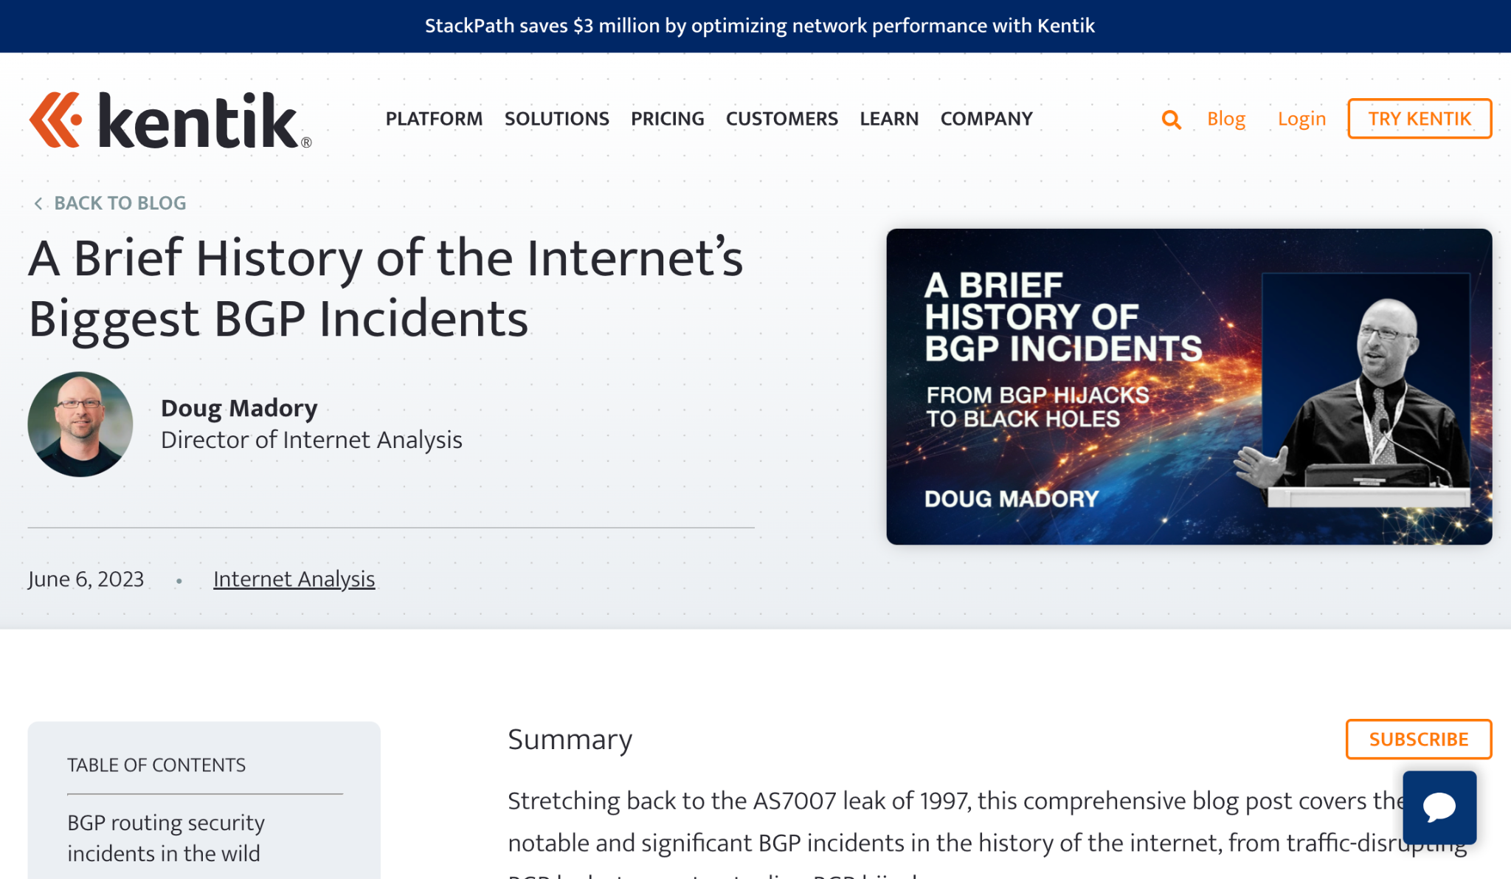
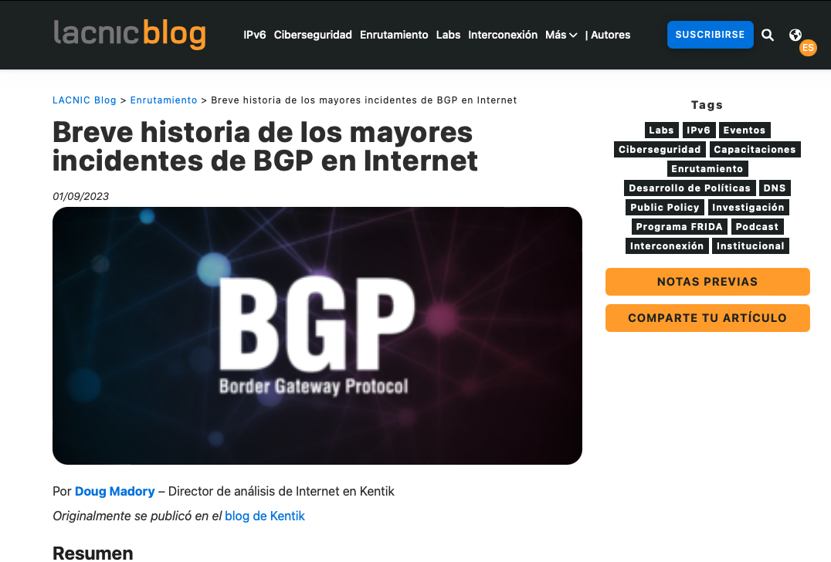
Originally part of BITAG Routing Security report
https://www.bitag.org/Routing_Security.php
Published on Kentik blog
https://www.kentik.com/blog/a-brief-history-of-the-internets-biggest-bgp-incidents/
Translated by LACNIC (en Español)
https://blog.lacnic.net/enrutamiento/breve-historia-de-los-mayores-incidentes-de-bgp-en-internet

Slide 3
Let’s stroll through the history of BGP incidents
These incidents are problematic because:
1
2
Disruption of flow of legitimate traffic
Misdirection of communications

Slide 4
Let’s stroll through the history of BGP incidents
Consider the spectrum of BGP incidents…
Until a few years ago, we couldn’t prevent much along this line.
Bonehead errors
Determined adversary
Degree of difficulty of mitigation

Slide 5
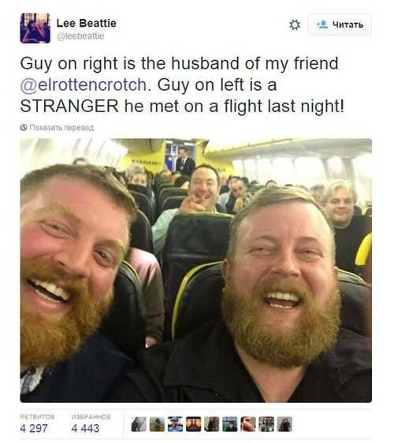
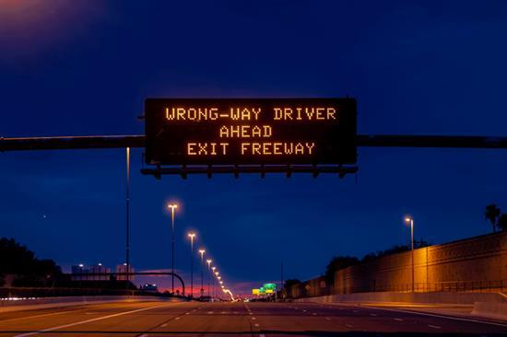
Disruptions due to leaks
“A route leak is the propagation of routing announcement(s) beyond their intended scope.” - RFC7908 (Problem Definition and Classification of BGP Route Leaks)
Origination
Adjacency
Leaker
Correct origin

Slide 6
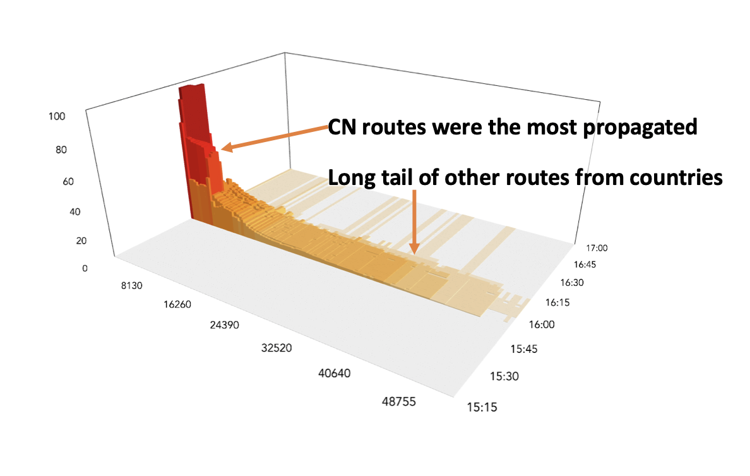
Disruptions due to leaks - Origin leaks
AS7007 leak (April 1997)
1st major disruption caused by a routing leak
Software bug caused a router to originate a large part of the global routing table
Numerous large origination leaks since AS7007:
Turk Telecom leak (Dec 2004)
China Telecom leak (Apr 2010)
Telecom Malaysia leak (Jun 2015)
And more…
Propagation of China Telecom Leak
Visualizing Routing Incidents in 3D (NANOG 78)

Slide 7
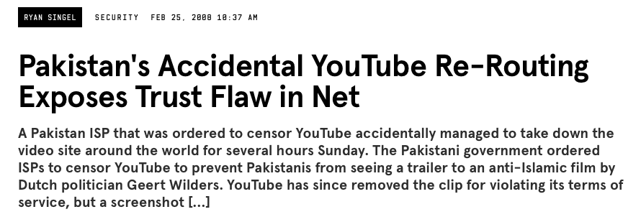
Leaked hijacks: Intentional, but also accidental
Twitter/X (104.224.42.0/24)
Hijacked during 2021 Myanmar military coup
Hijacked during 2022 Russian crackdown on social media
Difference between events was Twitter’s roll-out of RPKI
More recently:
Notes:
A particle and a wave

Slide 8
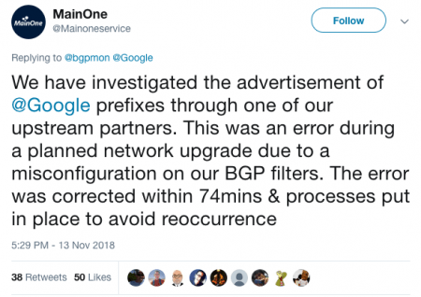
Disruptions due to leaks - Adjacency leaks
MainOne (AS37282) leak (Nov 2018)
Passed peer routes to transit providers.
China Telecom carried routes to Internet
Google, Cloudflare among disrupted networks.
Allegheny Technologies (AS396531) leak (Jun 2019)
~29k routes passed from one provider to another.
Route-optimizer generated many more-specifics.
Cloudflare experienced largest disruption as a result.
Origins were intact in these leaks.
Ex leaked Google path: … 4809 37282 15169
Ex leaked Cloudflare path: … 701 396531 33154 13335

Slide 9
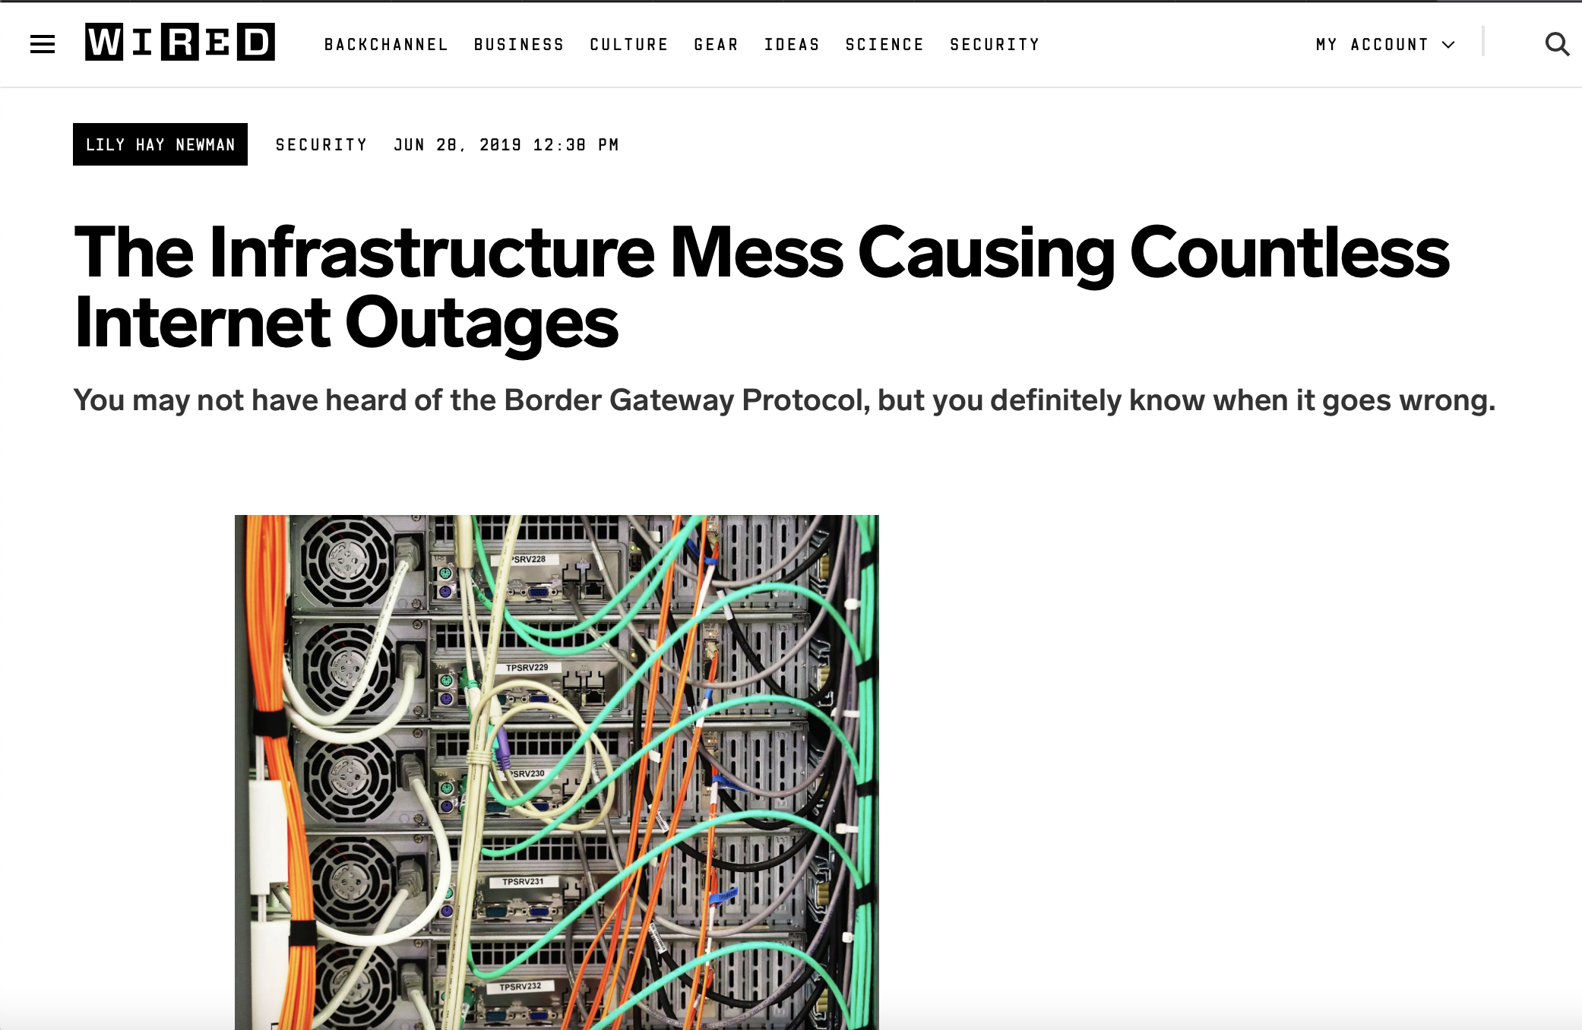
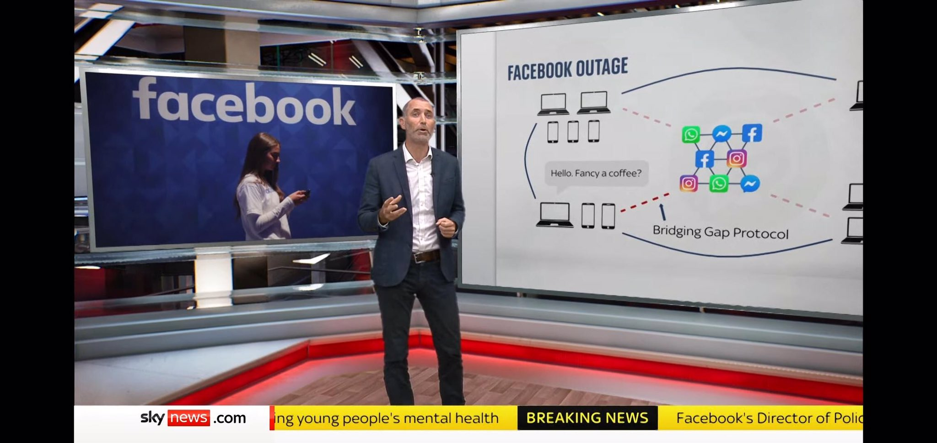
🙀 Bridging gap protocol is hopeless! 🙀
But wait … is it though?

Slide 10
Ask yourself: When was the last debilitating BGP routing leak?
Are our fingers getting less fat? Definitely not.

Slide 11
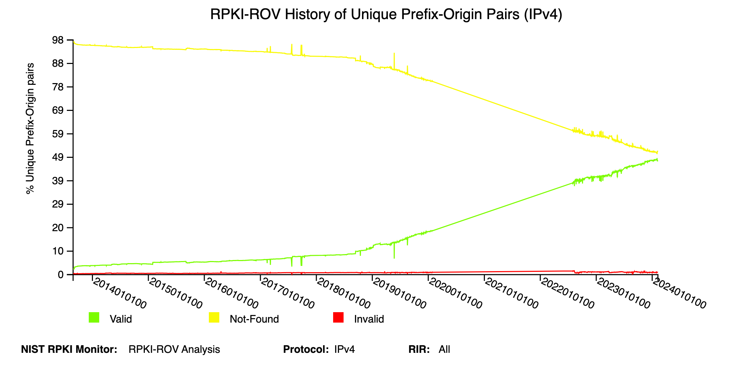
We’re making progress … no really!
Enormous progress in recent years as Tier-1 NSPs agreed to reject RPKI-Invalids.
NTT, GTT, Arelion (Telia), Cogent, Telstra, PCCW, Lumen, and more!
According to NIST RPKI Monitor, the trend line is going in the right direction!
Unknown going ↓
These lines are about to cross!
(lines for v6 crossed last year)
Valid going ↑
https://rpki-monitor.antd.nist.gov

Slide 12
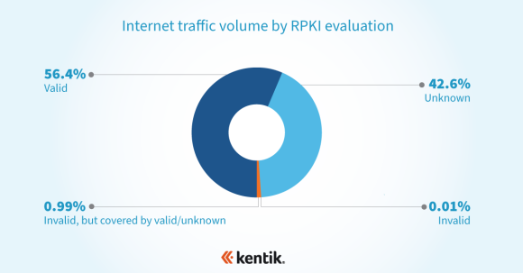
We’re making progress … no really!
Feb 2022: Only ~1/3 of BGP routes have ROAs - but how much traffic? The majority of it.
UPDATE: ~50% BGP routes have ROAs, now 67.9% of traffic in bits/sec (Feb 2024)
(50% of Thai routes have ROAs, 80.5% of traffic)
https://www.kentik.com/blog/exploring-the-latest-rpki-rov-adoption-numbers/
*Combined IPv4 + IPv6

Slide 13
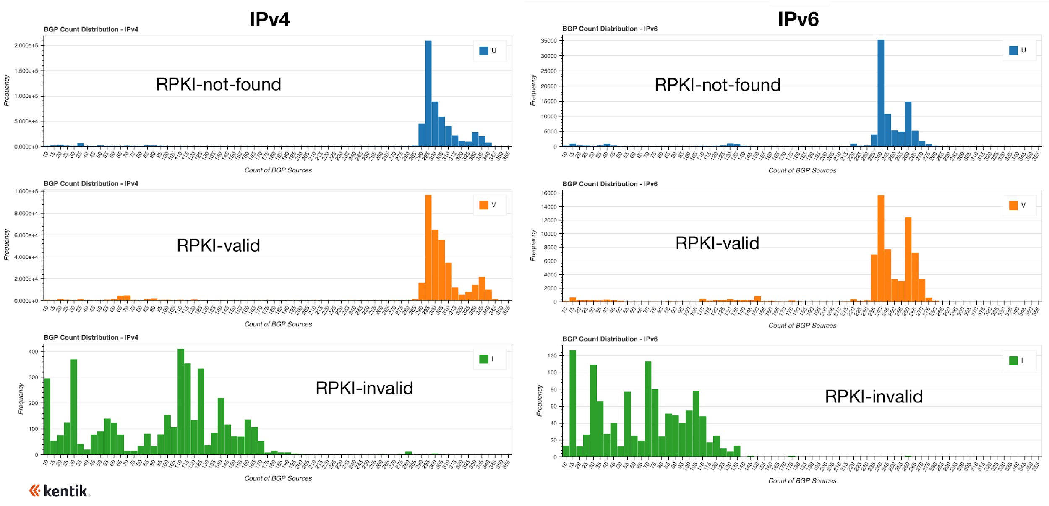
Is RPKI ROV reducing the propagation of RPKI-invalid routes?
ROAs alone are useless if only a few networks are rejecting invalid routes.
Recent analysis shows propagation of RPKI-invalid routes is half or less than other types.
https://www.kentik.com/blog/how-much-does-rpki-rov-reduce-the-propagation-of-invalid-routes/

Slide 14
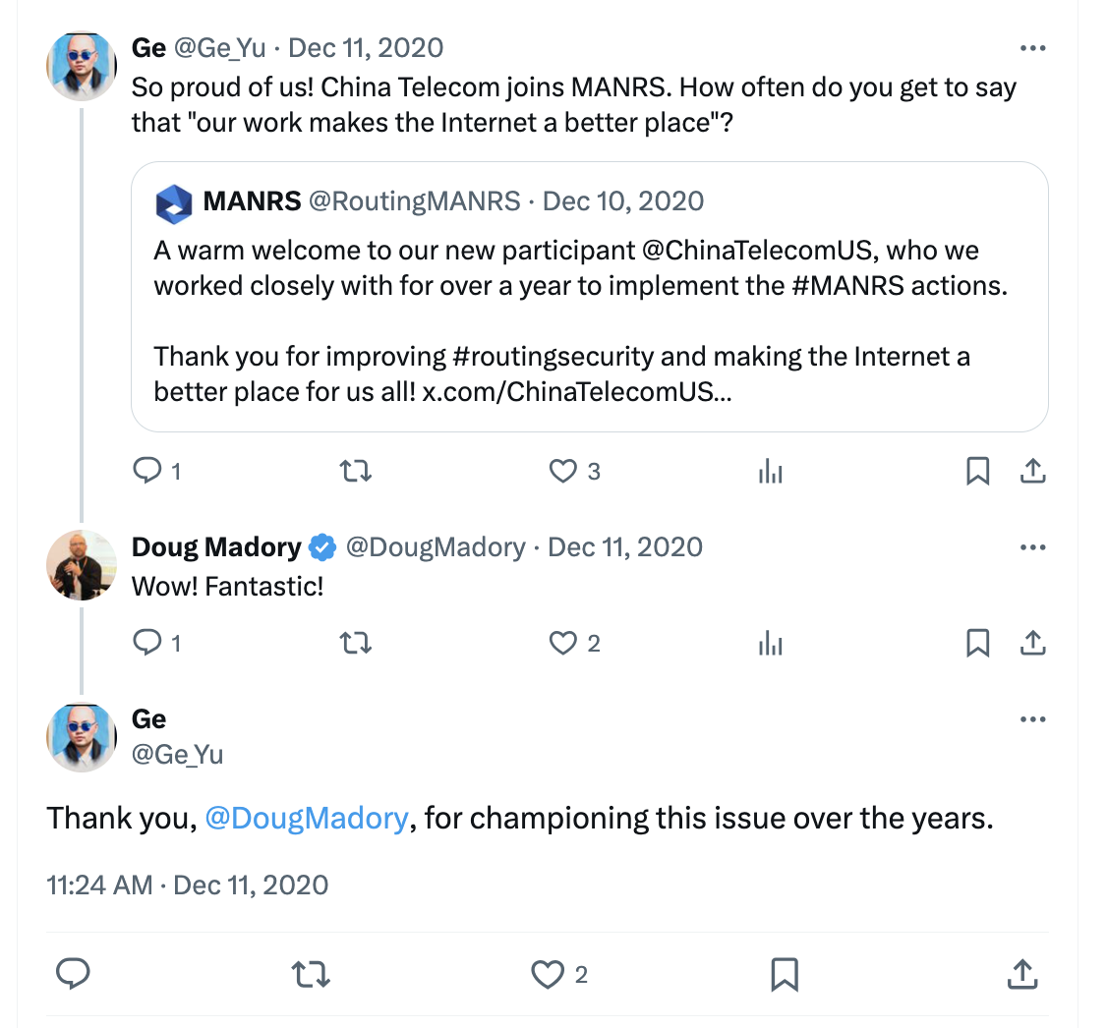
It’s not just RPKI
General improvement in route hygiene.
Peerlock, IRR-filtering, more awareness, etc
China Telecom has not been involved in a major BGP route leak since joining MANRS.

Slide 15
Facts I'd like to become common knowledge:
The majority of traffic is directed to RPKI-valid routes
Route propagation is cut in half when RPKI-invalid

Slide 16
Global routing system can be (and has been) manipulated to redirect Internet traffic

Slide 17
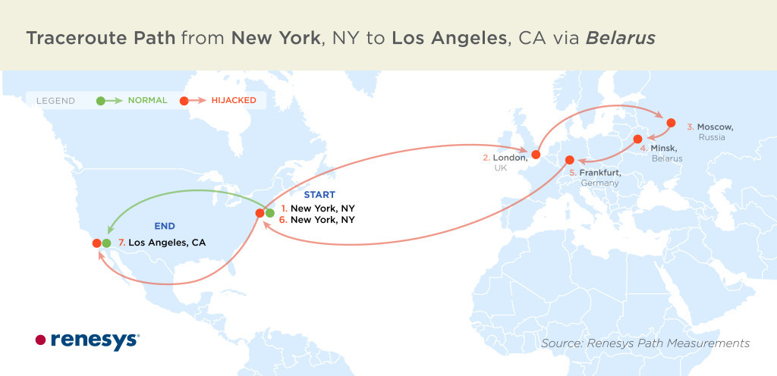
Misdirection of communications (hijacks!)
2008: Pilosov-Kapela theorizes use of BGP in MITM attack
2013: Renesys identifies MITM BGP hijacks coming from Belarus
Used BGP communities to shape route propagation
Targeted US financial institutions and foreign ministries of numerous governments
https://www.wired.com/2013/12/bgp-hijacking-belarus-iceland/

Slide 18
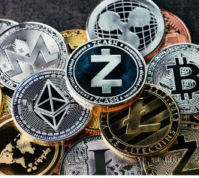
BGP Hijacks Targeting Cryptocurrency Services
Prior attacks against cryptocurrency services
Etherwallet (Apr 2018)
Klayswap (Feb 2022)
Attack against Celer Bridge (August 2022)
https://www.kentik.com/blog/bgp-hijacks-targeting-cryptocurrency-services/

Slide 19
Attack against Celer Bridge (August 2022)
Celer Bridge is a service to convert between cryptocurrencies.
Attacker used a BGP hijack against AWS to impersonate Celer Bridge.
Redirected digital assets to attacker’s wallet.
Why was the BGP hijack successful?

Slide 20
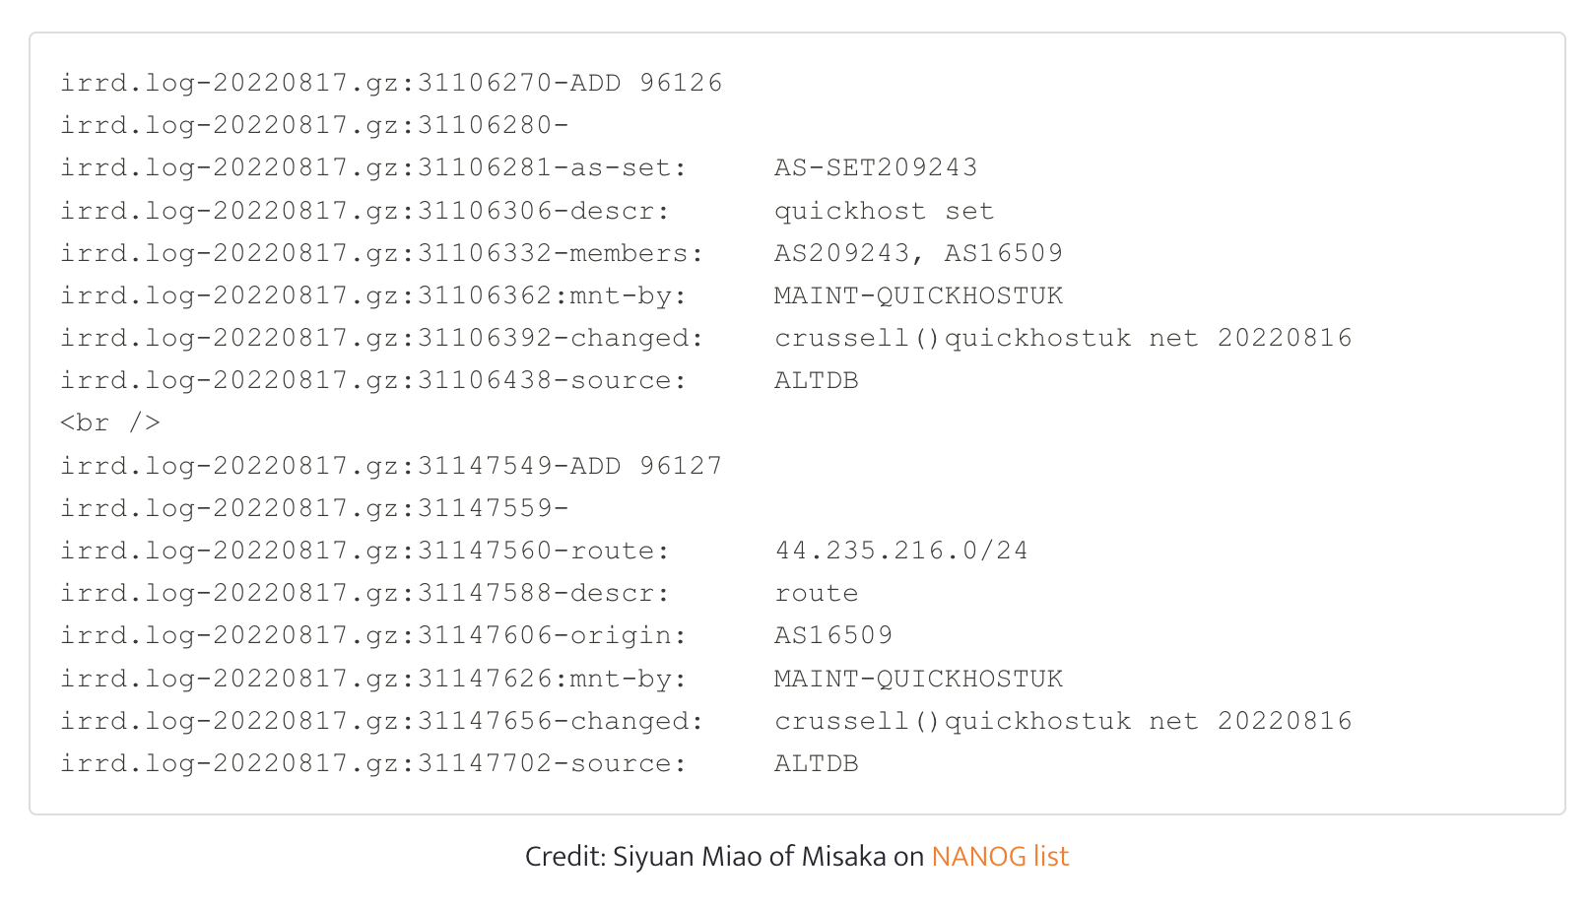
Attack against Celer Bridge (August 2022)
Attacker needed to ensure malicious BGP announcements wouldn’t get filtered
Inserted bogus route objects for QuickhostUK in AltDB (free RIR alternative)

Slide 21
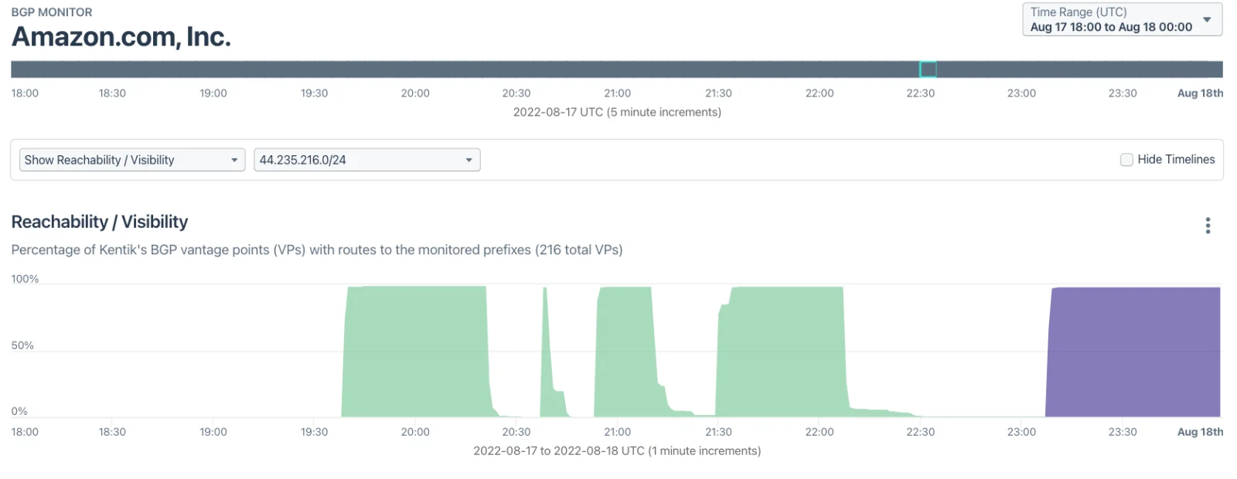
Attack against Celer Bridge (August 2022)
Attacker needed to ensure malicious BGP announcements wouldn’t get filtered
Inserted bogus route objects for QuickhostUK in AltDB (free RIR alternative)
Attacker altered AS_PATH to appear to be originated by an Amazon ASN.
AS_Path: … 1299 209243 14618
https://twitter.com/DougMadory/status/1562089866321698819
Malicious route
Legit

Slide 22
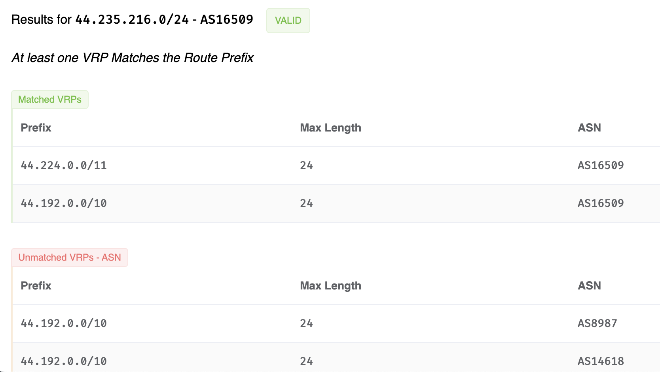
How do we prevent these attacks?
RPKI ROV
Amazon had an ROA for the hijacked prefix, so why didn’t ROV help?
Very liberal ROAs: 3 different Amazon ASNs allowed to announce parts of this IP space with prefixes ranging in size from /10 to /24 (!)
See RFC 9319 : The Use of maxLength in the Resource Public Key Infrastructure (RPKI)
Leaving the maxLength field blank in a ROA has the same effect as setting the maxLength field to match the prefix.

Slide 23
How do we prevent these attacks?
RPKI ROV
Amazon had an ROA for the hijacked prefix, so why didn’t ROV help?
Very liberal ROAs: 3 different Amazon ASNs allowed to announce parts of this IP space with prefixes ranging in size from /10 to /24 (!)
Need BGPSEC to eliminate impersonation of ASes.
Protection only extends via contiguous BGPSEC-aware ASes
Adoption by major cloud providers and network service providers alone could severely limit the efficacy of AS impersonations
Partial deployment does offer benefits.

Slide 24
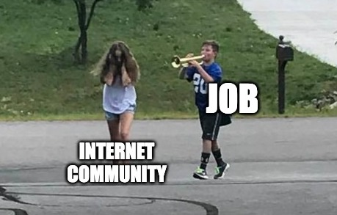
More progress to come
Expect to hear from a certain routing security evangelist soon!
Peerlock ✅
Using RPKI to cleanup IRR ✅
RPKI ✅
To reduce impacts of fat-fingers.
ASPA (being fielded)
To reduce impacts of adjacency leaks.
BGPSEC (needed)
To eliminate origin impersonation.

Slide 25
We’re “moving the needle” on routing security!
Things are improving and it isn’t by accident.
Let’s Go!
Bonehead errors
Determined adversary

Slide 26
Thank you!
Visit us at our booth
Jac Kloots
jac@kentik.com
in/jackloots

