Slide 1
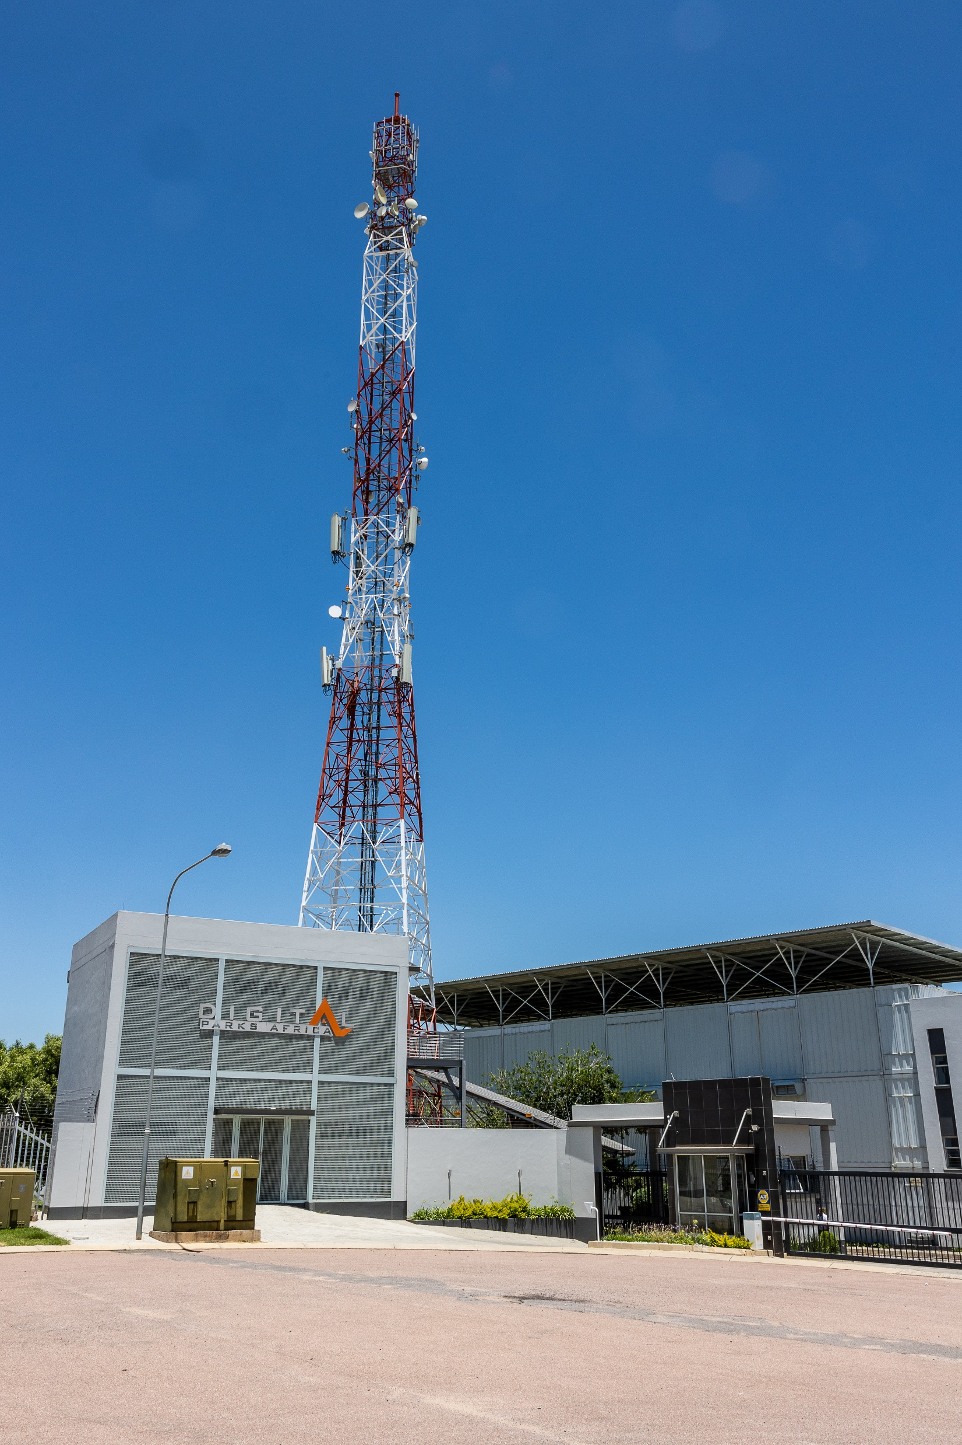
The Digital Heartbeat of Africa
Innovation in Data Centres
Server Cooling

Slide 2
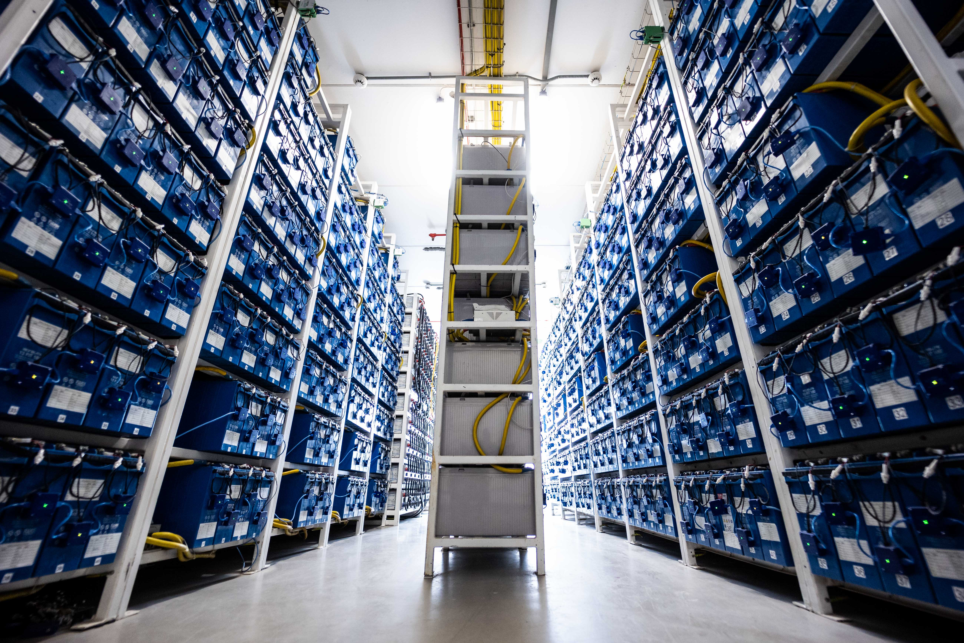
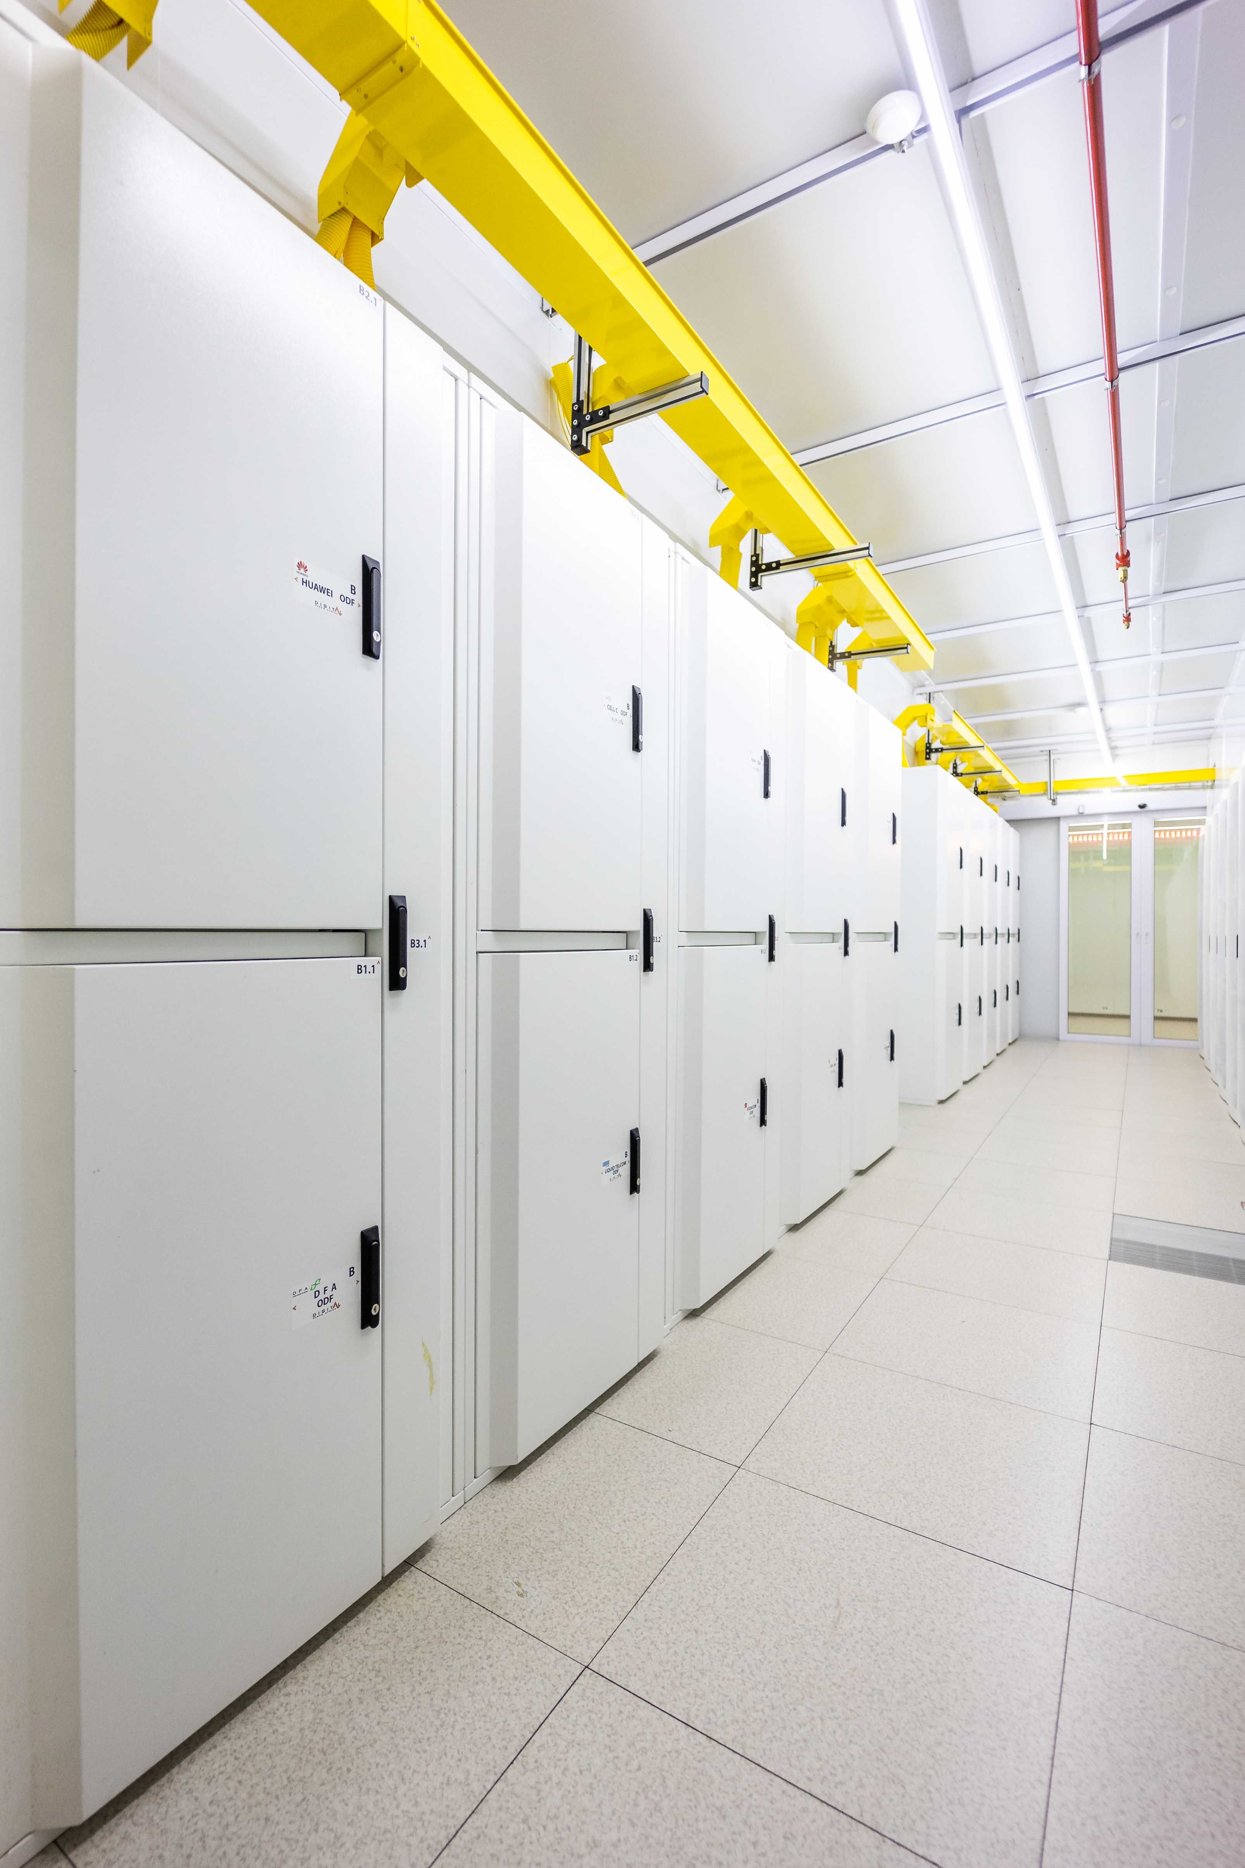
Drivers for change
New infrastructure demands
Additional considerations
High Performance cooling
Close

Slide 3
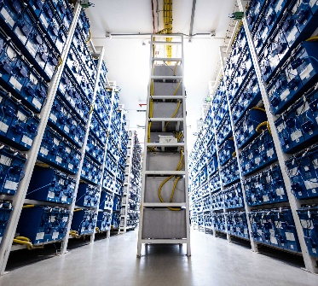
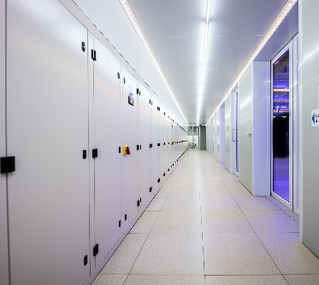
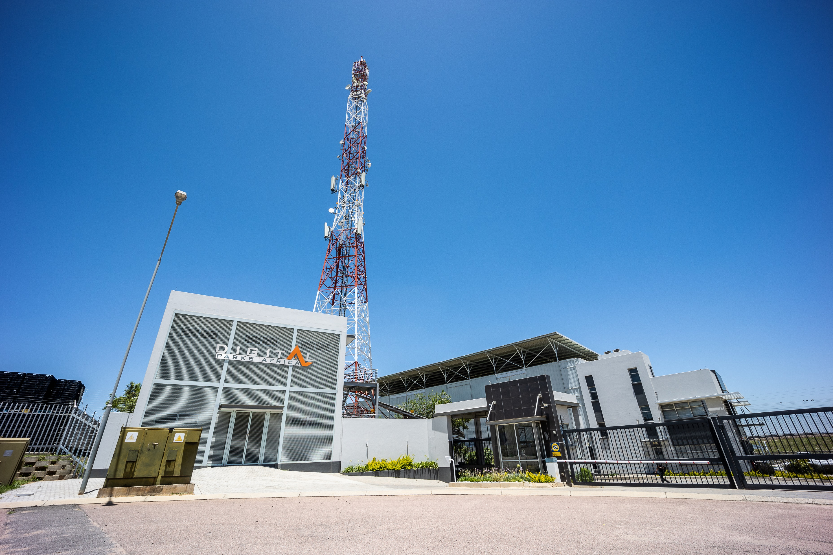
Drivers for change
Emergence of High-performance computing driven by new applications e.g.: generative AI
ESG considerations for PUE optimisation
Cost considerations

Slide 4
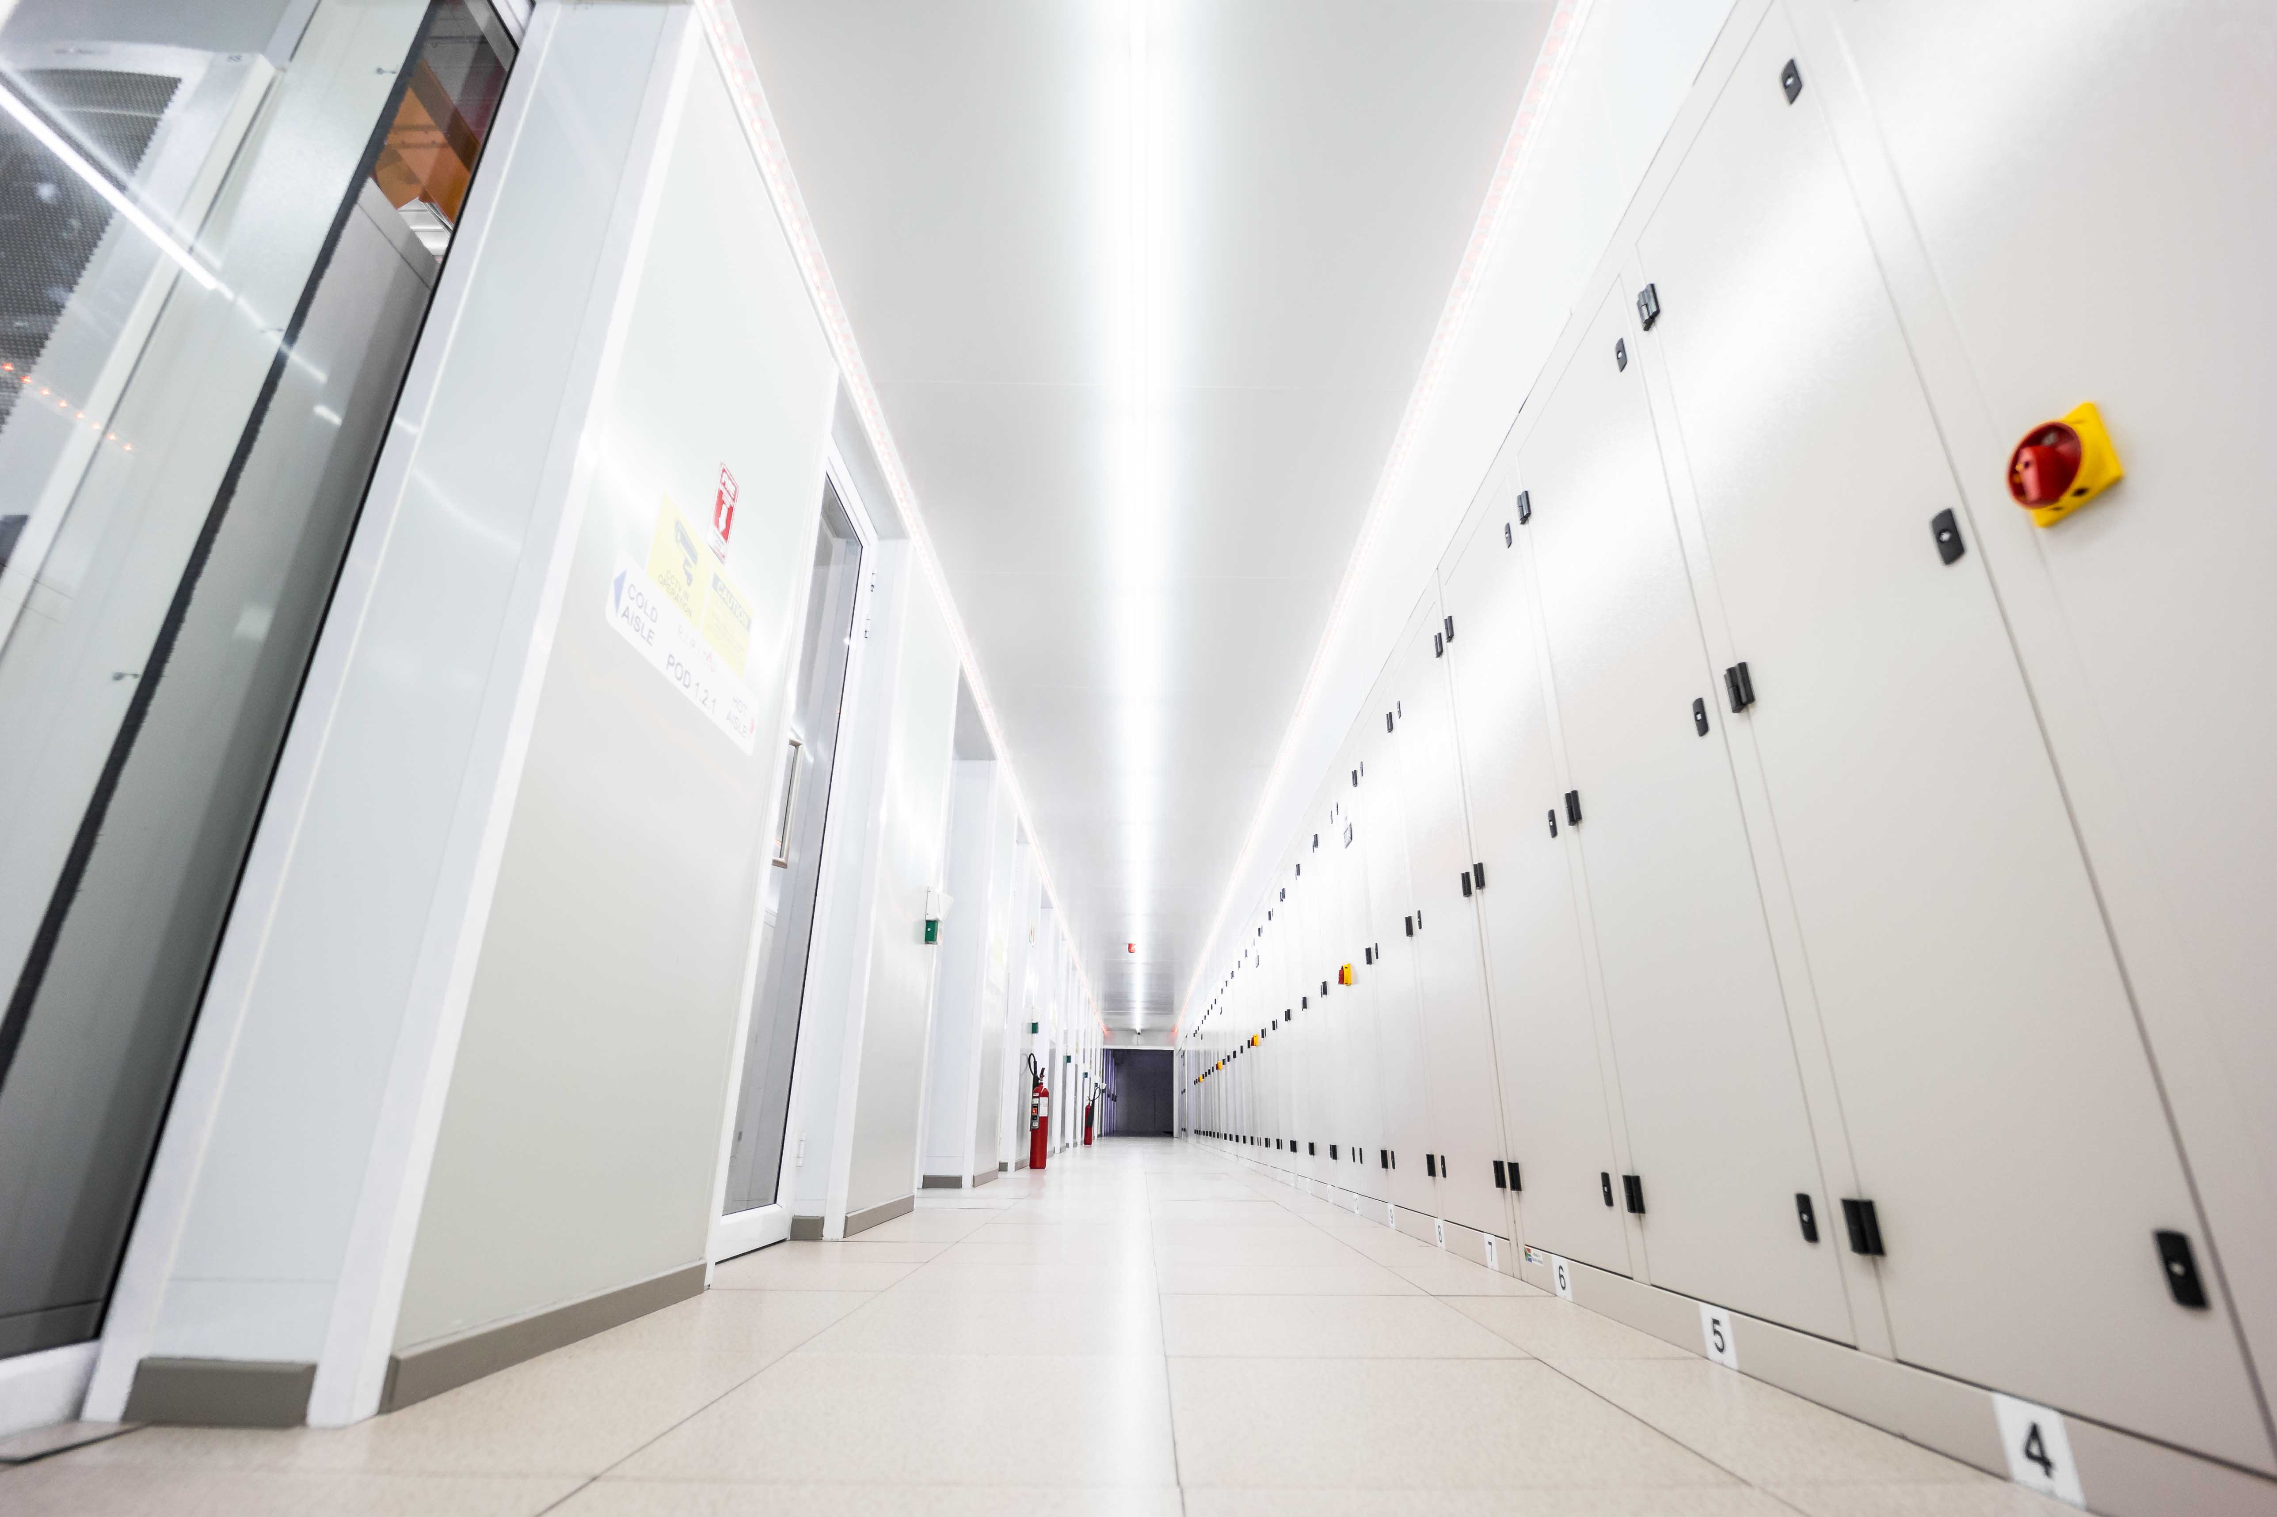
Infrastructure implications
Increase in server CPU power
(from 100W to 400W and above)
Increased Power density per rack
(our 15KW/rack insufficient in future)
Enhanced cooling requirements

Slide 5
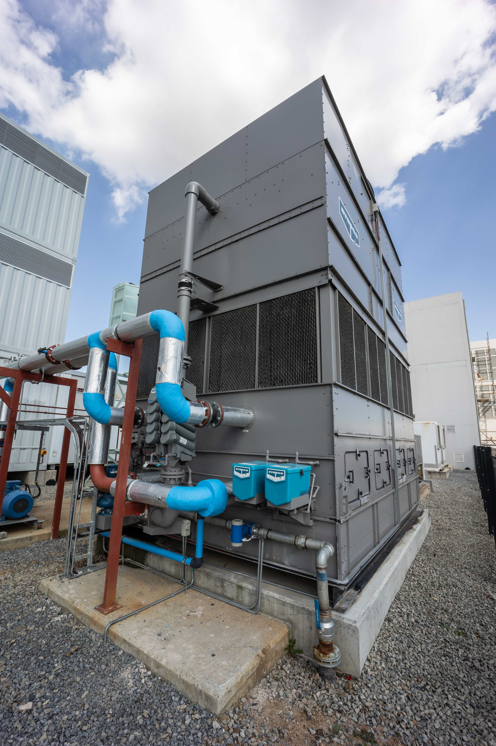
Other considerations
Improve efficiencies
Conform to Data Centre standards
(Tier certifications)

Slide 6
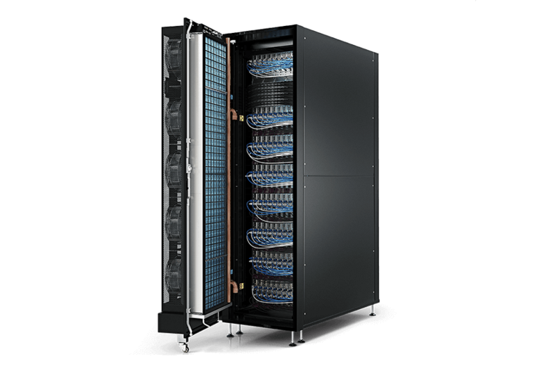
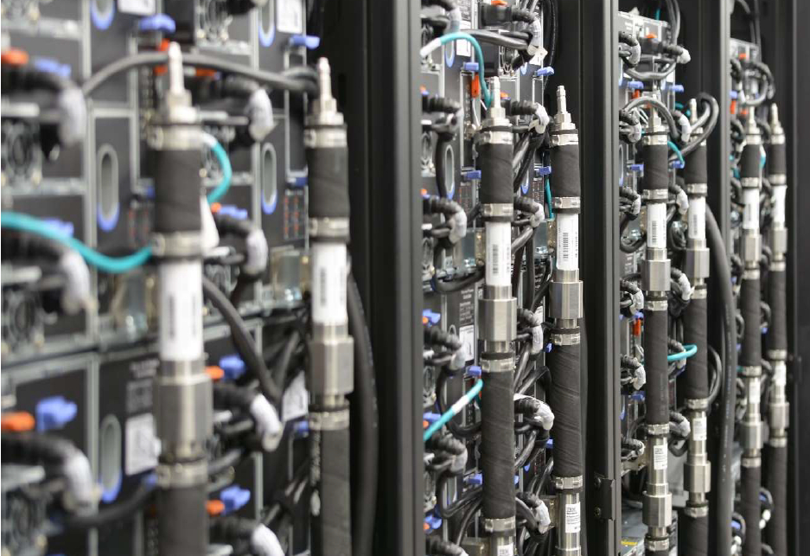
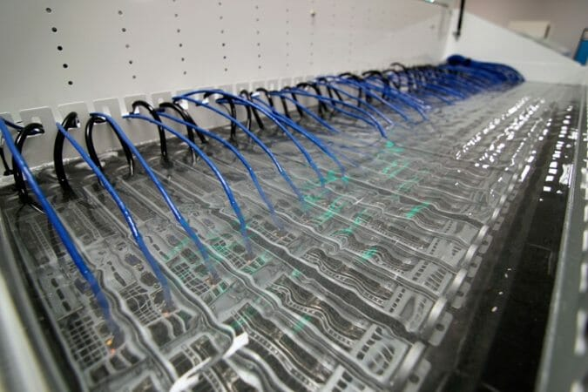
Forms of cooling technologies
Air cooling
(DPA Cold aisle containment)
Liquid cooling
Back of Rack heat exchanger
Water cooled to chip
Immersion cooling

Slide 7
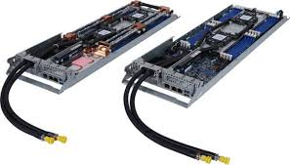
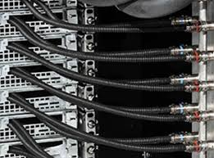
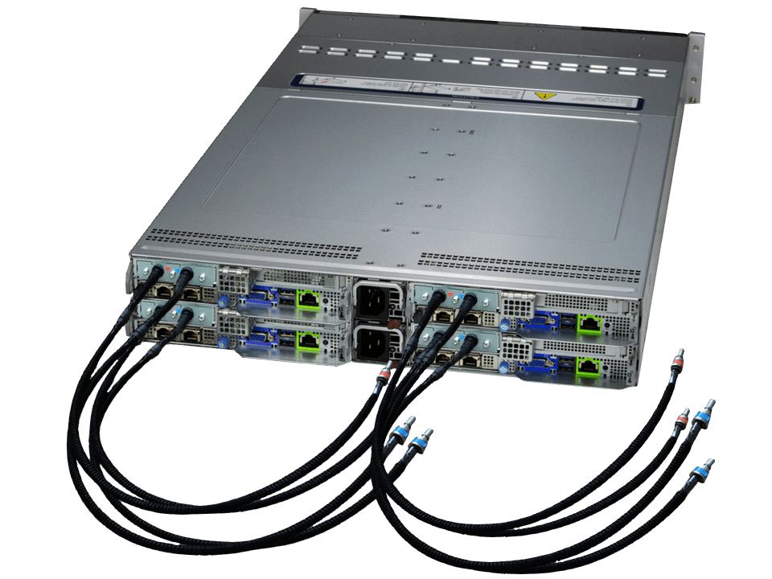
Hi Performance cooling methods
Liquid cooling direct to chip

Slide 8
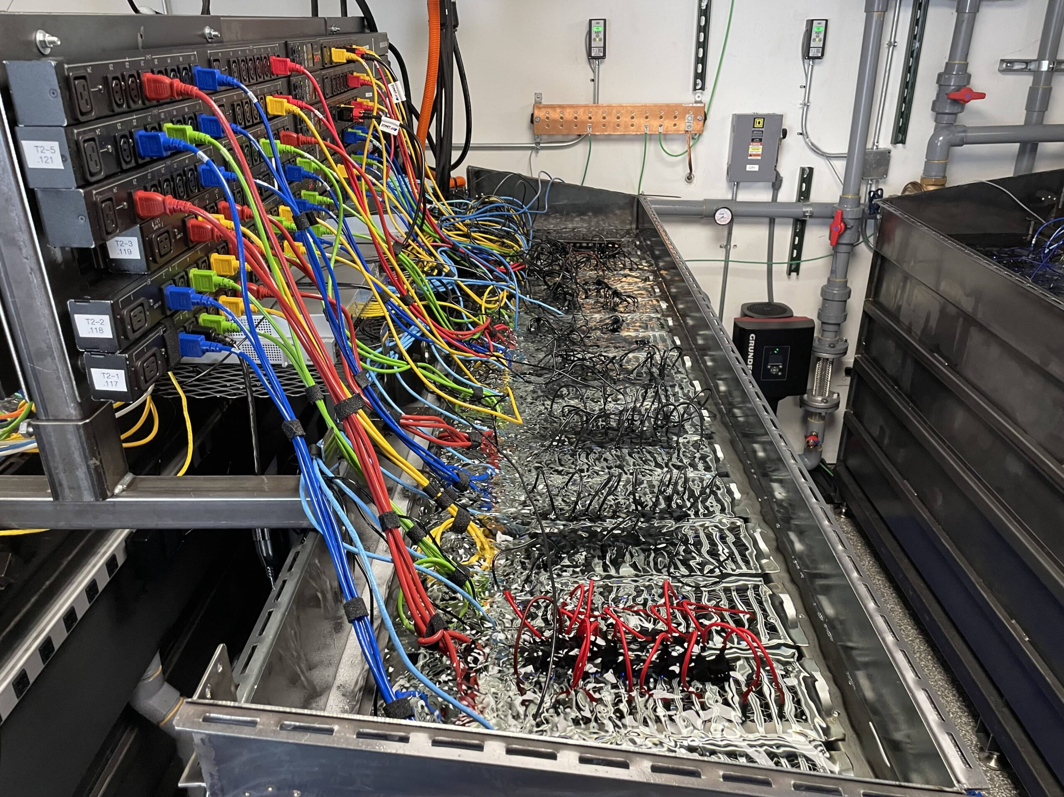
Immersion cooling
Single phase – coolant circulates in open tank

Slide 9
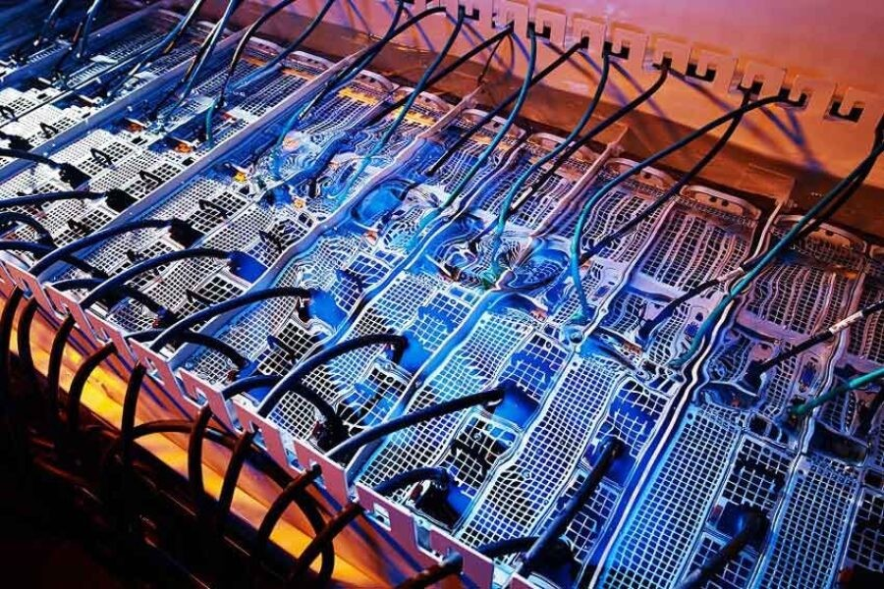
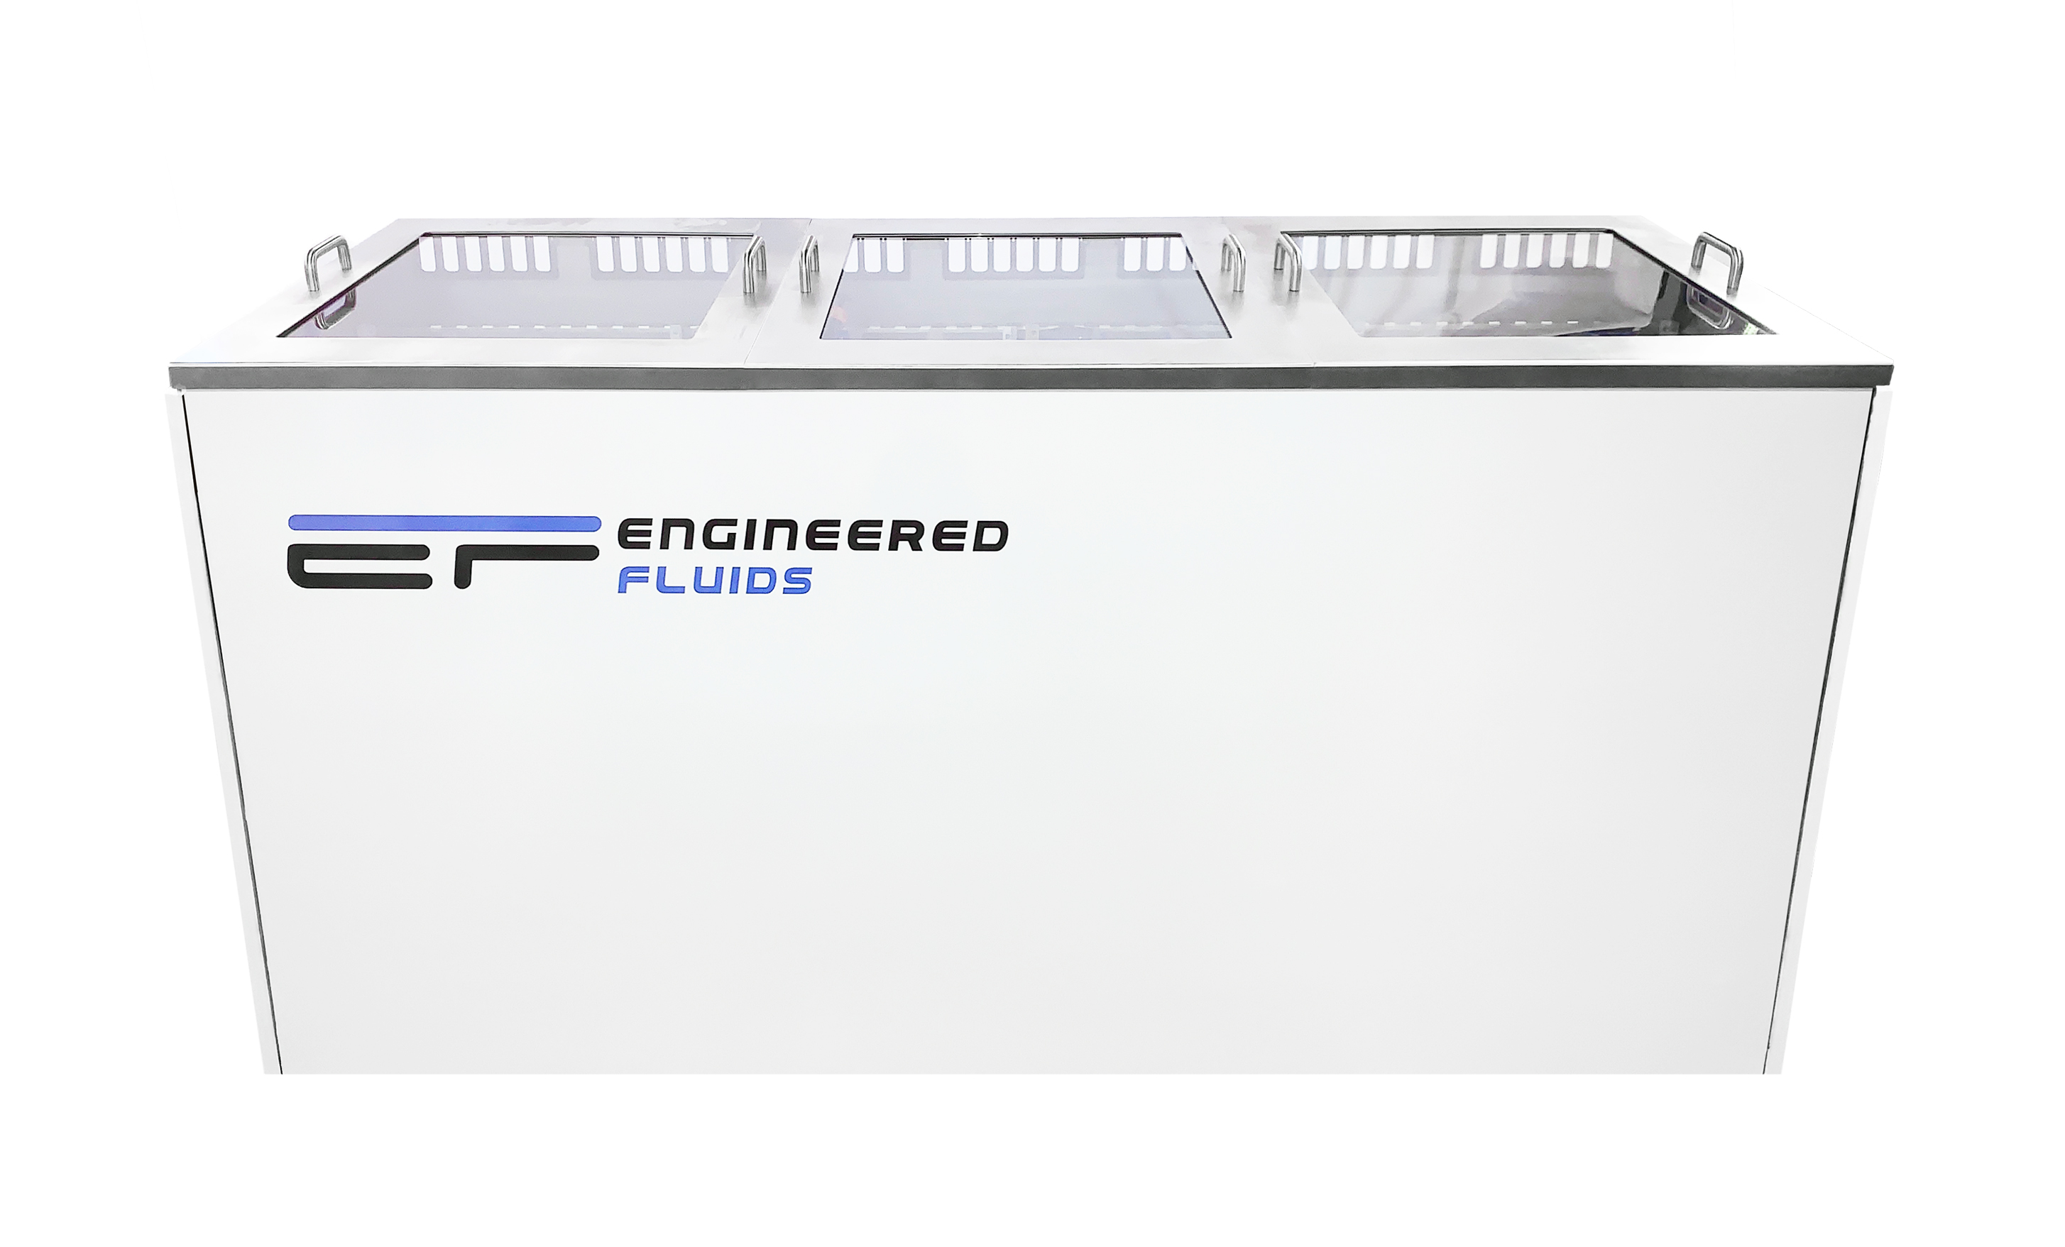
Single phase immersion cooled tank

Slide 10
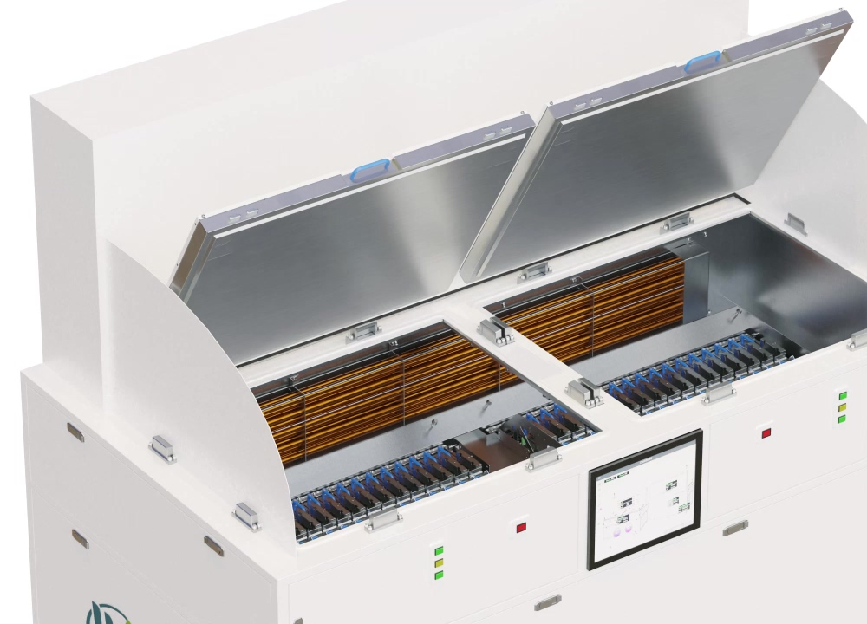
Immersion cooling
Two phase – coolant changes state in a closed system

Slide 11
Server adaptation for immersion cooling
Connector alignment
No on-board fans
OEM’s such as HPE, DELL, Lenovo, Gigabyte, Nvidia supply hardware

Slide 12
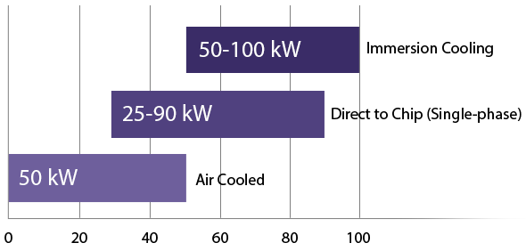
Cooling capabilities per Rack

Slide 13
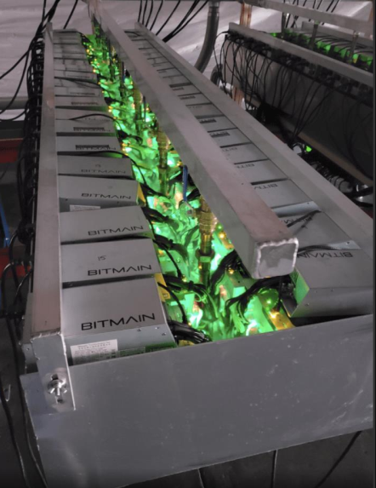
Key considerations and benefits of immersion cooling
Server fans consume up to 20% of power drain
Air cooling amounts to approximately 30% of Data center costs
Engineered cooling fluid is 1600x more thermally efficient
than air
Significant improvement in PUE
Dielectric strength of 60KV
Cooling fluid is bio-degradable, non allergenic, nontoxic,
noncorrosive
10-year operating life and 25-year shelf life

Slide 14
Implications for the Data center industry
Presently immersion cooling is still a niche technology
Increased uptake is driven by modern chip developments that require more effective cooling technology.
The Global Immersion Cooling Market Data Centers size is expected to grow from USD 379.96 million in 2022 to USD 1021.59 million by 2030

Slide 15
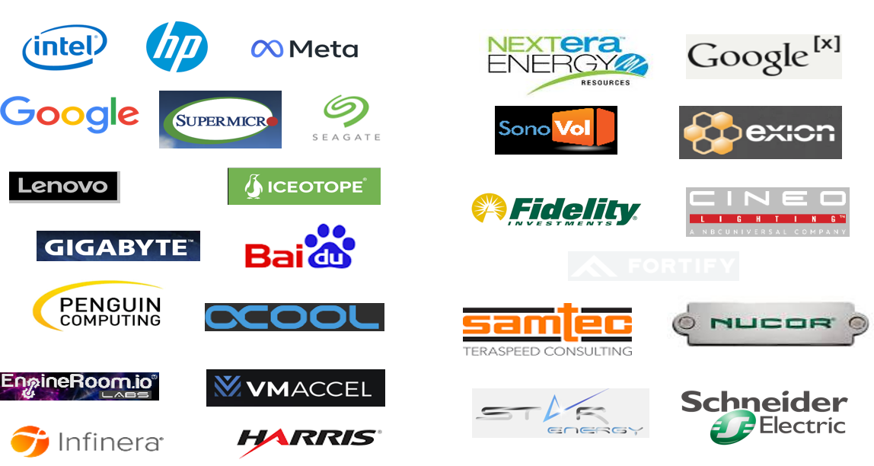
Adoption is well underway

Slide 16
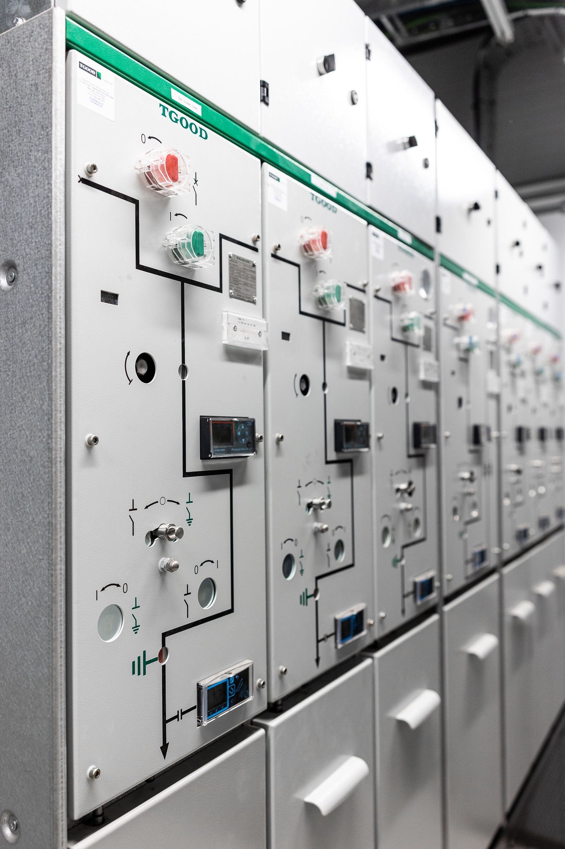
The Digital Heartbeat of Africa
THANK YOU
Eckart@DPA.HOST

