Slide 1
The Orange España hack and the state of BGP Security
Jac Kloots
Solutions Engineer
jac@kentik.com

Slide 2
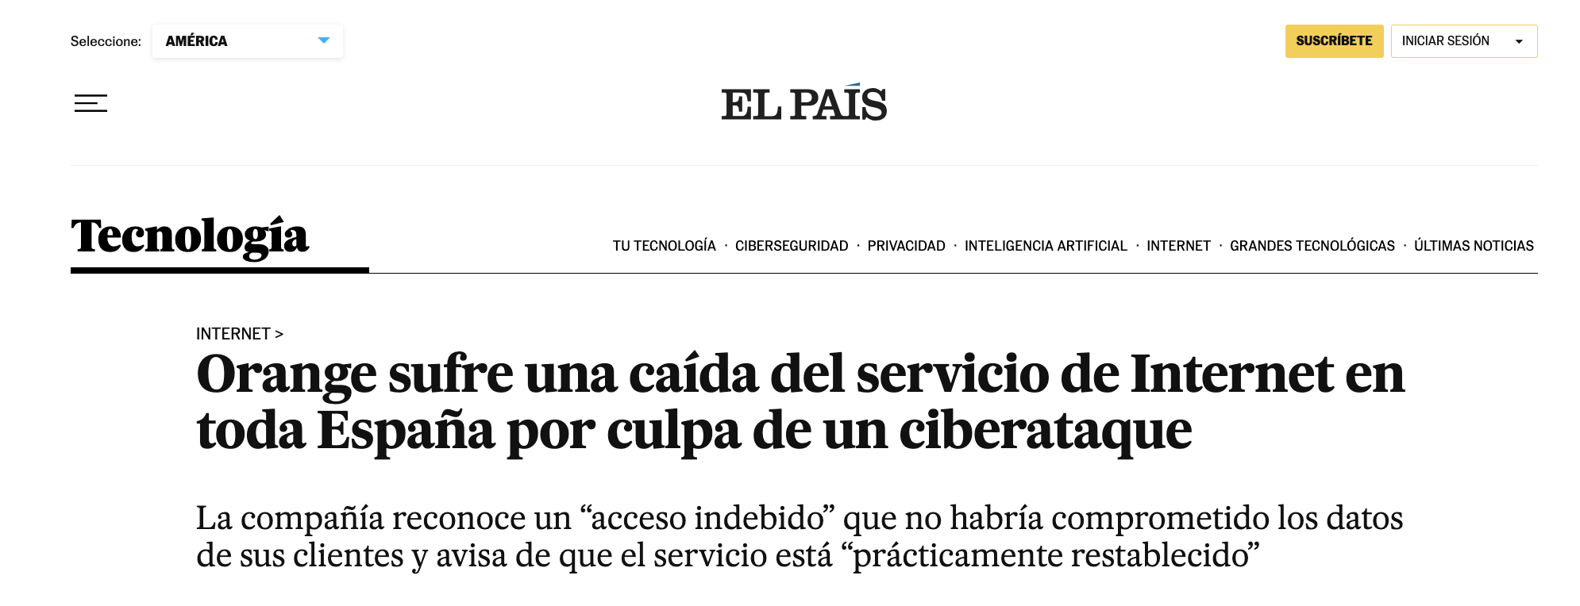
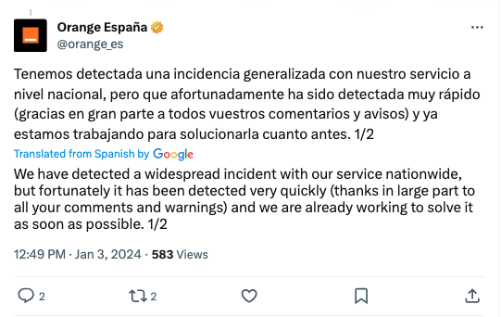
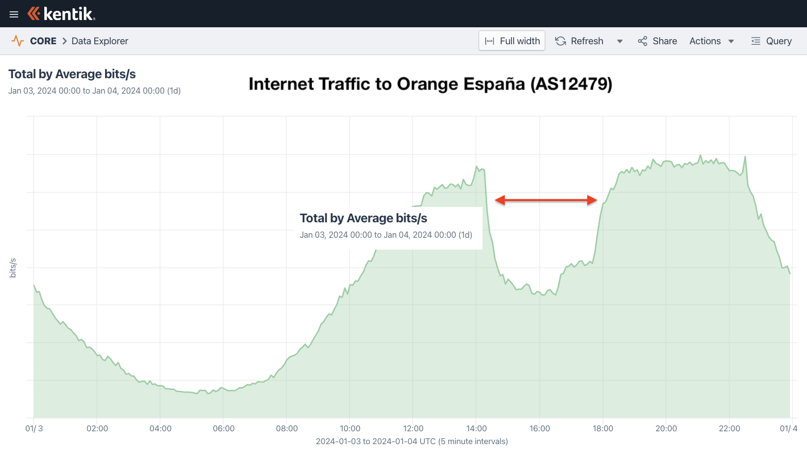
January 3, 2024
Orange suffers a drop in Internet service throughout Spain due to a cyber attack
The company recognizes “improper access” that would not have compromised its customers' data and warns that the service is “practically restored”
Notes:
What is this talk about: Orange Espana hack, but actually it is a story about routing security.
This is the first time the RPKI system was used as an attack vector.
Who does not know what RPKI is?

Slide 3
What is RPKI, ROA and ROV? A refresher
Resource Public Key Infrastructure (RPKI) is a cryptographic method of signing and distributing records to enable routing security applications.
Route origin validation (ROV) is a route security application that operates on the RPKI
  ROV validates BGP announcements against available ROAs.
  Often when people refer to the operation of RPKI, they are referring to ROV
Route origin authorization (ROA) is a record created by the resource (IP) owner that asserts the proper origin AS and maximum prefix length.
Autonomous System (AS) BGP parlance for an entity which routes internet traffic
AS Path is the sequence of AS numbers that a route propagates through
  Originally added for data loop prevention, but is also used in ROV
RPKI ROV is our best defense against accidental BGP hijacks and origination leaks, however, it cannot stop ‘determined adversary’ who can forge AS paths.

Slide 4
What is RPKI, ROA and ROV? A refresher
For RPKI ROV to do its job, two things must happen:
ROAs must be created by resource owners (typically using their RIR portal)
Networks must configure their routers to validate BGP messages and reject invalid routes.
Example ROA:
Prefix: 172.111.180.0/22 Max Length: 23 Origin ASN: 3223
ROV evaluation of BGP messages:
172.111.180.0/23 7922 6762 9009 (invalid AS)
172.111.180.0/24 7922 6762 3223 (invalid length)
172.111.180.0/23 7922 6762 3223 (valid)

Slide 5
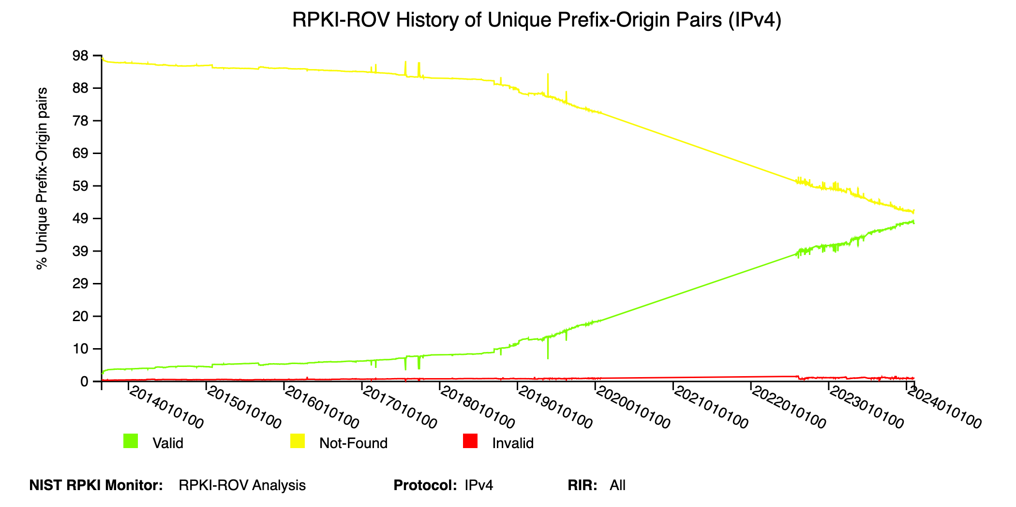
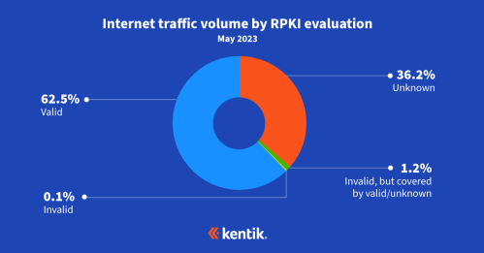
ROA Creation Progress
According to NIST RPKI Monitor, the trend line is going in the right direction!
Unknown going ↓
Valid going ↑
https://rpki-monitor.antd.nist.gov
https://www.kentik.com/blog/exploring-the-latest-rpki-rov-adoption-numbers/

Slide 6
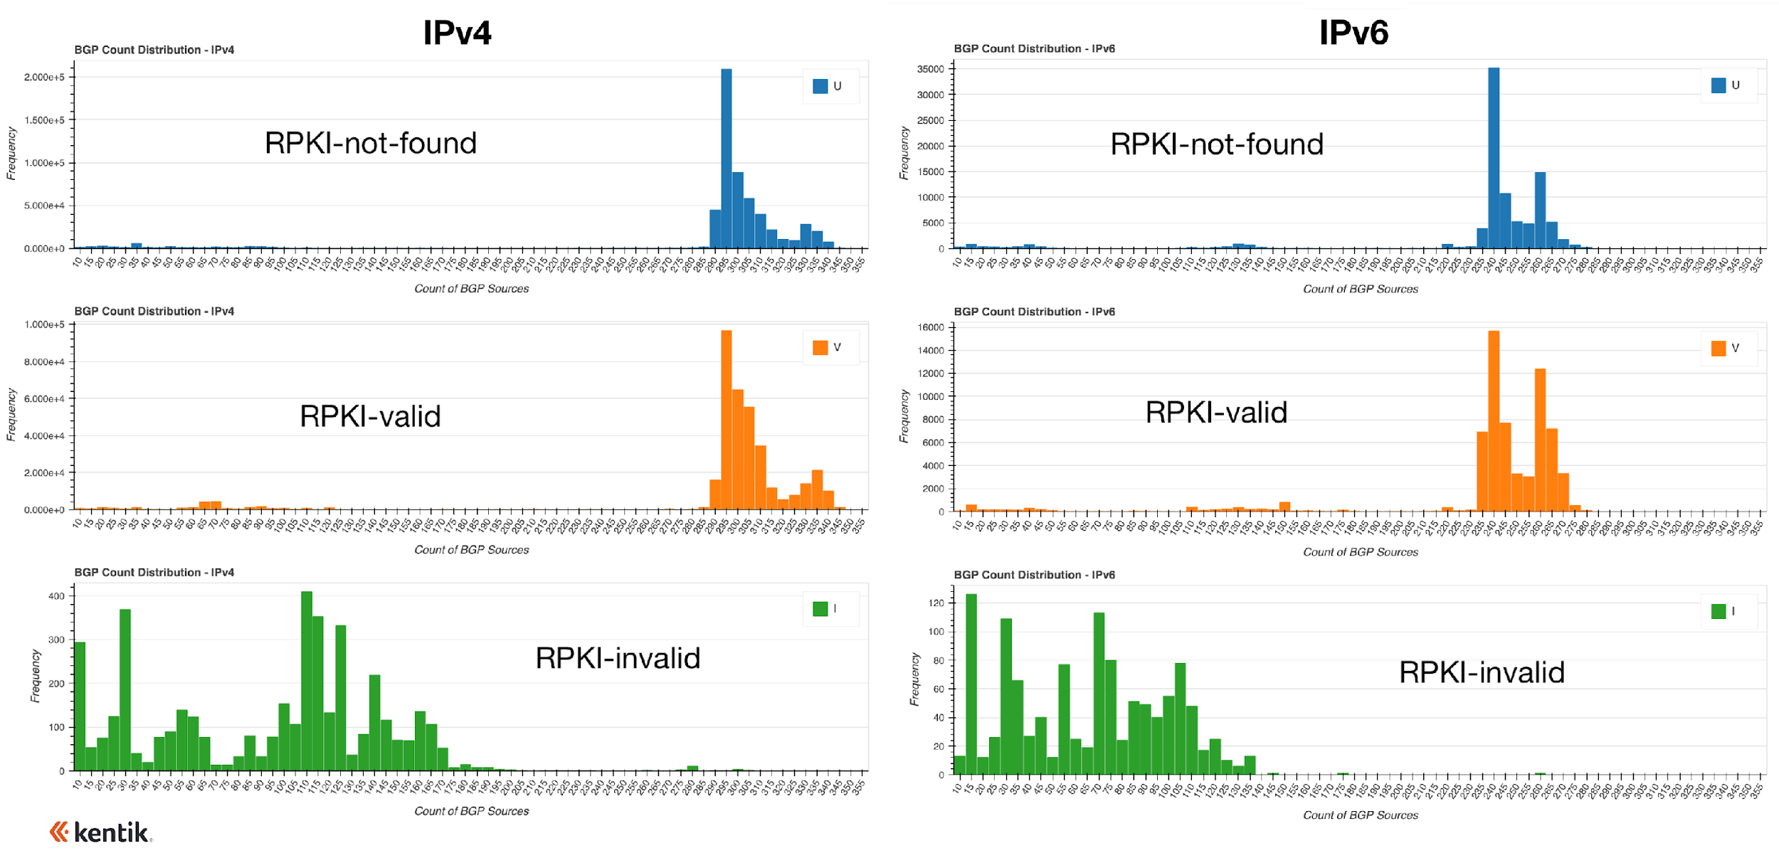
Is RPKI ROV reducing the propagation of RPKI-invalid routes?
ROAs alone are useless if only a few networks are rejecting invalid routes.
Our analysis shows propagation of RPKI-invalid routes is half or less than other types.
https://www.kentik.com/blog/how-much-does-rpki-rov-reduce-the-propagation-of-invalid-routes/

Slide 7
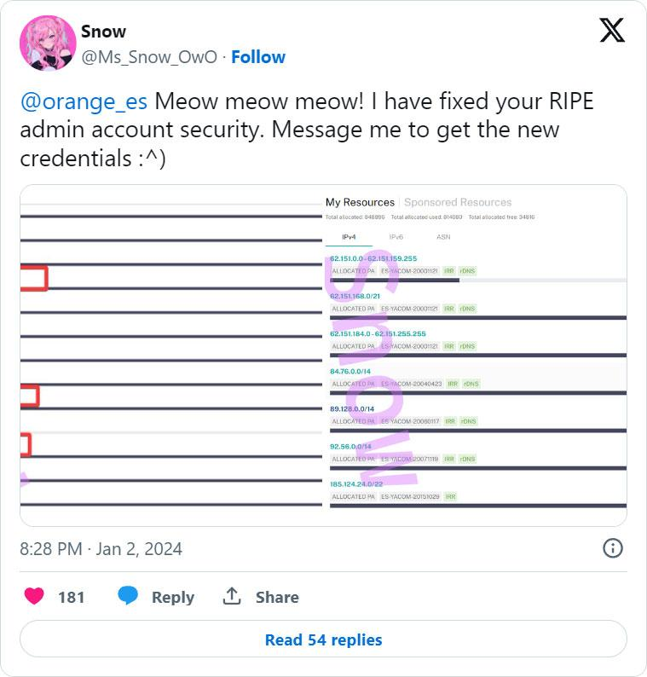
Why did Orange España suffer an outage?
Hacker was able to log into company’s RIPE NCC portal using the password “ripeadmin” found in a public leak of stolen credentials.
Hacker altered Orange España's RPKI configuration, rendering many of its BGP routes RPKI-invalid.
No traffic was misdirected, no data was compromised. However, Orange España routes became unreachable due to filtering of RPKI-invalid routes.
Outage marked the first time RPKI ROV was used as a vector for a denial-of-service.

Slide 8
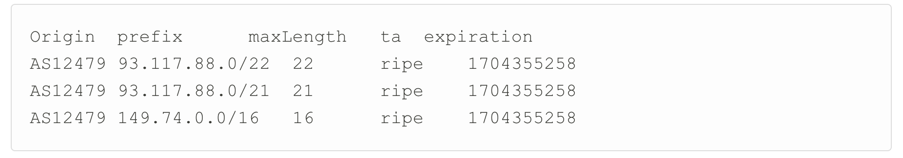
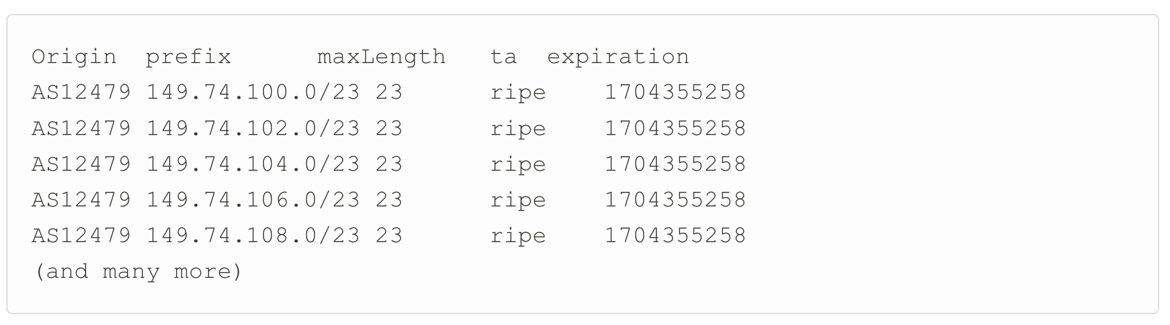
Why did Orange España suffer an outage?
First it started with the creation of a couple of new ROAs.
A maxlength was set on these three prefixes with a correct originating ASN.
For the /22 and /21 this wasn’t an issue. The /16 had more specifics that got invalid after this change. They soon realized this and more ROAs where created:

Slide 9
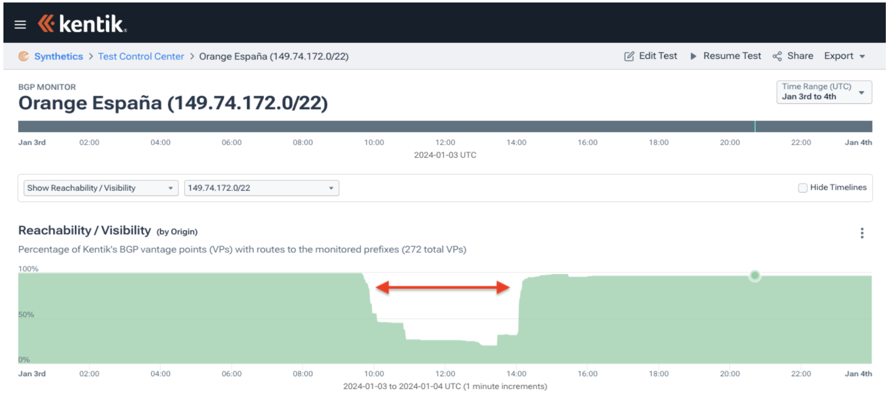
Why did Orange España suffer an outage?
The prefix that was missed was 149.74.172.0/22

Slide 10
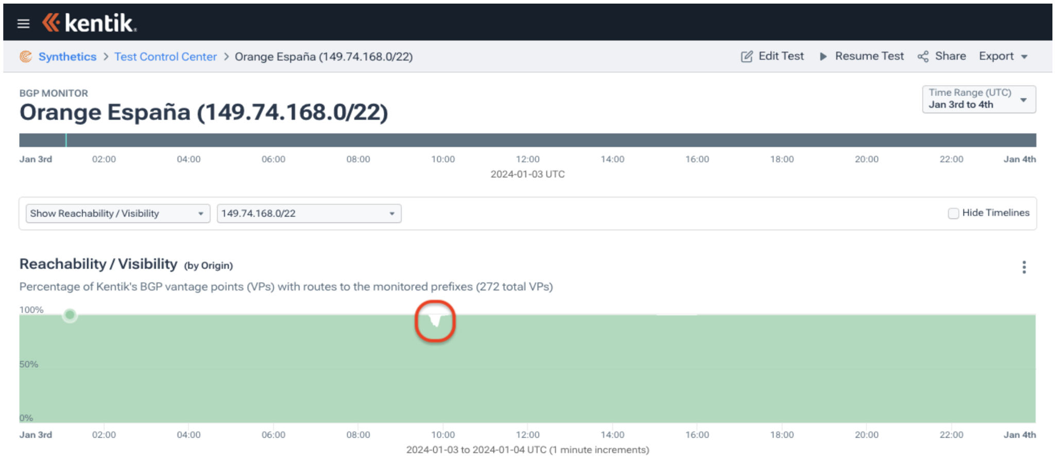
Why did Orange España suffer an outage?
Conversely, the rest of the more-specifics looked like 149.74.168.0/22 below: a brief partial drop in reachability between the first and second publications of ROAs
Notes:
ROAs propagate slow so this impact was just small.

Slide 11
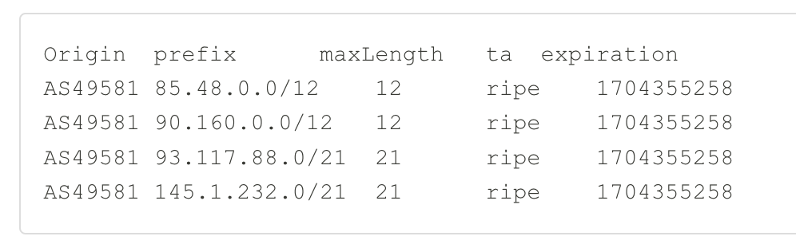
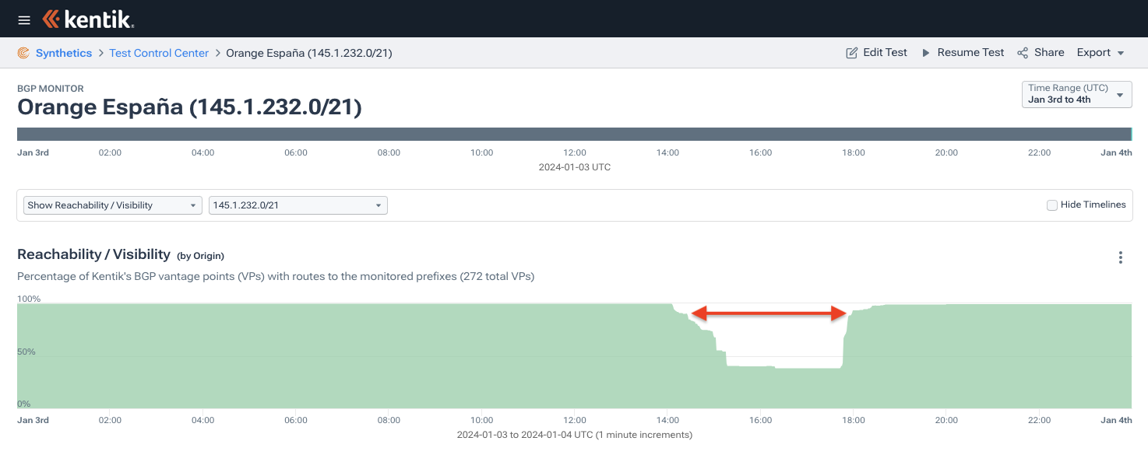
Why did Orange España suffer an outage?
Then the attacker took it a bit further and changed the ROAs again, the attacker published the following ROAs:
Orange España’s ASN is 12479, so all these routes suddenly did not match the ROAs which asserted AS49581 is the proper origin. Also, the routes are more-specific than a /12.
Legitimate routes became invalid and were rejected, limiting their propagation.

Slide 12
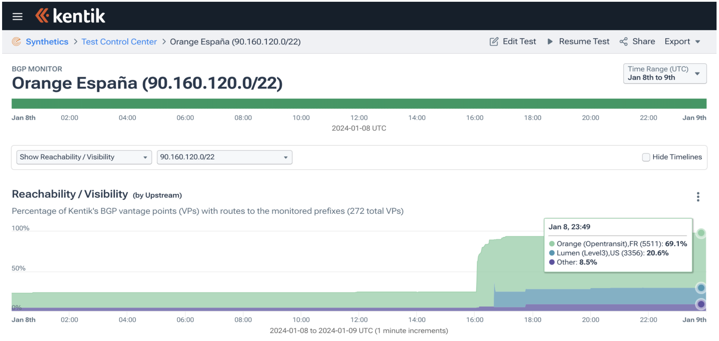
Why did Orange España suffer an outage?
It wasn’t until just before 18:00 UTC (7pm local) that things began to return to normal. Engineers from Spain’s second largest mobile operator regained control of their RIPE NCC account and began publishing new ROAs that would enable the carrier to restore service.
After this most prefixes rendered valid again, but one was missed. I took till 8 january before services was restored completely.
Notes:
ROAs propagate slow so this impact was just small.

Slide 13
Conclusion
RPKI is a powerful instrument for securing routing, but as it is powerful for securing, it also is a strong attack vector.
I would remind anyone creating ROAs that max prefix length is an optional field and can simply be left empty causing RPKI to only match on the origin of the ROA. This course of action was recently published as a best current practice.
Hopefully this incident can serve as a wake-up call to other service providers that their RIR portal account is mission-critical and needs to be protected by more than a simple password.
Notes:
ROAs propagate slow so this impact was just small.

Slide 14

Thank you!
Visit us at our booth
Jac Kloots
jac@kentik.com
in/jackloots

